Slide 1
Chapter 7: TECHNIQUES OF INTEGRATION
Contents:
7.1 Integration by Parts
7.2 Trigonometric Integrals
7.3 Trigonometric Substitution
7.4 Integrals Involving Hyperbolic and Inverse Hyperbolic Functions
7.5 The Method of Partial Fractions
7.6 Strategies for Integration
7.7 Improper Integrals
7.8 Numerical Integration

Slide 2

7.1 Integration by Parts (1 of 13)
In this section, we derive a formula that often allows us to convert an integral that we cannot immediately evaluate into one that we can. The Integration by Parts formula is derived from the Product Rule. Let u and v be functions of x:
$$\frac{d}{dx}\left(uv\right)=u\frac{dv}{dx}+v\frac{du}{dx}$$
According to this formula, uv is an antiderivative of the right-hand side, so
$$uv=\int{u\frac{dv}{dx}}dx+\int{v\frac{du}{dx}}dx$$
Moving the second integral on the right to the other side, we obtain
$$\int{u\frac{dv}{dx}}dx=uv−\int{v\frac{du}{dx}}dx$$

Slide 3

7.1 Integration by Parts (2 of 13)
By letting $du=\frac{du}{dx}dx$ and $dv=\frac{dv}{dx}dx$, we find the following:
Integration by Parts: $\int{udv}=uv−\int{vdu}$
Because Integration by Parts applies to a product, we should consider using it when the integrand is a product of two functions. It is not, however, a product rule for antidifferentiation, because we cannot always use Integration by Parts to find an antiderivative of a product. Sometimes it works, as with f (x) = x cos x; other times it does not, as in the case of f (x) = x tan x. Sometimes when the integrand is not expressed directly as a product, an application of Integration by Parts enables us to find an antiderivative.

Slide 4

7.1 Integration by Parts (3 of 13)
EXAMPLE:
To evaluate $\int{x\cos{x}}dx$, we write $x\cos{x}dx=udv$ with u = x and $dv= \cos{x}dx$. Differentiating u and antidifferentiating dv, we find
$du=\frac{du}{dx}dx=1dx$ and $v=\sin{x}$. By the Integration by Parts formula,
$$\int{x}\cos{x}dx=x\sin{x}−\int{\sin{x}}dx=x\sin{x}+\cos{x}+C$$
Let’s check the answer by taking the derivative:
$$\frac{d}{dx}\left(x\sin{x}+\cos{x}\right)=x\cos{x}+\sin{x}−\sin{x}=x\cos{x}$$

Slide 5

7.1 Integration by Parts (4 of 13)
The key step in Integration by Parts is deciding how to write the integral as a product u dv. Keep in mind that Integration by Parts expresses $\int{udv}$ in terms of uv and $\int{vdu}$. This is useful only if vdu is easier to integrate than udv. Here are two guidelines:
Choose dv so that $v=\int{dv}$ can be evaluated.
Choose u so that $\frac{du}{dx}$ is “simpler” than u itself.
The choices for u and dv that we made in the last example were good because they enabled us to transform the integral to a simpler one. A bad choice would be u = cos x and dv = xdx. With du = − sin xdx and $v =\frac{1}{2}x^{2}$, the Integration by Parts formula gives the more complicated
$$\int{x\cos{x}dx=\frac{1}{2}x^{2}\cos{x}+\int{\frac{1}{2}x^{2}\sin{x}}dx}$$

Slide 6

7.1 Integration by Parts (5 of 13)
EXAMPLE: Integrating by Parts More Than Once To evaluate $\int{x^{2}\cos{x}dx}$, we apply Integration by Parts a first time with u = x² and dv = cos x dx:
$$\int{x^{2}\cos{x}dx}=x^{2}\sin{x}−\int{2x\sin{x}dx}=x^{2}\sin{x}−2\int{x\sin{x}dx}$$
Now apply it again to the integral on the right, this time with u = x and dv = sin x dx:
$$\int{x\sin{x}dx=−x\cos{x}−\int{−\cos{x}dx}=}−x\cos{x}+\sin{x}+C$$
$$\int{x^{2}\cos{x}dx}=x^{2}\sin{x}−\int{2x\sin{x}dx}=x^{2}\sin{x}−2\int{x\sin{x}dx}$$
$$=x^{2}\sin{x}+2x\cos{x}−2\sin{x}+C$$

Slide 7

7.1 Integration by Parts (6 of 13)
The function f (x) = ln x is one of the basic functions for which we have not yet seen an antiderivative formula. Now, with Integration by Parts, we can obtain one.
EXAMPLE: Taking dv = dx If we try to evaluate $\int{\ln{x}dx}$, then the integrand is not a product. However, we can treat ln x dx as a product of ln x and dx. Then u = ln x, $du=\frac{1}{x}dx$, dv = dx, and v = x. Hence,
$$\int{\ln{x}dx}=x\ln{x}−\int{x\frac{1}{x}dx}=x\ln{x}−\int{dx}=x\ln{x}−x+C$$

Slide 8

7.1 Integration by Parts (7 of 13)
Let’s check the result of the previous example by differentiation:
$$\frac{d}{dx}\left(x\ln{x}−x\right)=\ln{x}+x\frac{1}{x}−x=\ln{x}$$
Now, we can add the indefinite integral of f (x ) = ln x to our table of integral formulas:
$$\int{\ln{x}dx=x\ln{x}}−x+C$$
There is a convenient definite-integral version of the Integration by Parts formula:
$$\int_{a}^{b}{udv}=uv|_{a}^{b}−\int_{a}^{b}{vdu}$$

Slide 9

7.1 Integration by Parts (8 of 13)
EXAMPLE: Red Fox Dispersal The red fox disperses from its place of birth. For any x between 0 and 10, the likelihood that a fox breeds its first offspring within x kilometers of its birthplace is $\int_{0}^{x}{0.2e^{−0.16t}}dt$. With such a model, the average birth-to-breeding distance can be determined via the integral $\int_{0}^{10}{0.2xe^{−0.16x}}dx.$
To compute this integral, we use Integration by Parts with u = x and dv = 0.2e^{−0.16x} dx. Then du = dx and $v=−1.25e^{−0.16x}.$ Thus,
$$\int_{0}^{10}{0.2xe^{−0.16x}}dx=−1.25xe^{−0.16x}|_{0}^{10}+\int_{0}^{10}{1.25e^{−0.16x}dx}$$
$$=−1.25xe^{−0.16x}|_{0}^{10}−\frac{1.25}{0.16}e^{−0.16x}|_{0}^{10}≈3.71$$

Slide 10

7.1 Integration by Parts (9 of 13)
EXAMPLE: Going in a Circle? When evaluating $\int{e^{x}}\cos{x}dx$, there are two reasonable ways of writing e^{x} cos x dx as u dv. Let’s try setting u = cos x. Then we have $dv=e^{x}dx$, $du=−\sin{x}dx$, and $v=e^{x}.$ Thus,
$$\int{e^{x}\cos{x}dx}=e^{x}\cos{x}+\int{e^{x}\sin{x}dx}$$
Now use Integration by Parts on the last the integral with u = sin x, $dv=e^{x}dx$, $du=\cos{x}dx$, and $v= e^{x}$ to obtain $\int{e^{x}\sin{x}dx}=e^{x}\sin{x}−\int{e^{x}\cos{x}dx}$. So,
$$\int{e^{x}\cos{x}dx}=e^{x}\cos{x}+\int{e^{x}\sin{x}dx}$$
$$=e^{x}\cos{x}+e^{x}\sin{x}−\int{e^{x}\cos{x}dx}$$

Slide 11

7.1 Integration by Parts (10 of 13)
Now we can add $\int{e^{x}\cos{x}dx}$ to both sides. Note that we add a + C to the right side since we no longer have an integral on that side of the equation that will generate the necessary arbitrary constant:
$$2\int{e^{x}\cos{x}dx}=e^{x}\cos{x}+e^{x}\sin{x}+C$$
$$\int{e^{x}\cos{x}dx}=\frac{1}{2}e^{x}\left(\sin{x}+\cos{x}\right)+C$$

Slide 12

7.1 Integration by Parts (11 of 13)
EXAMPLE: A Reduction Formula We show
$$\int{\sin^{n}{x}dx}=−\frac{1}{n}\sin^{n−1}{x}\cos{x}+\frac{n−1}{n}\int{\sin^{n−2}{x}dx}$$
We apply Integration by Parts as follows: $u=\sin^{n−1}{x}$, $dv=\sin{x}dx$, $v=−\cos{x}$, and $du=\left(n−1\right)\sin^{n−2}{x}\cos{x}dx.$ We obtain
$$\int{\sin^{n}{x}dx}=−\sin^{n−1}{x}\cos{x}+\int{\left(n−1\right)\sin^{n−2}{x}\cos^{2}{x}dx}$$
Using $\cos^{2}{x}=1−\sin^{2}{x}$, we get
$$\int{\sin^{n}{x}dx}=−\sin^{n−1}{x}\cos{x}+\int{\left(n−1\right)\sin^{n−2}{x}(1−\sin^{2}{x})dx}$$

Slide 13

7.1 Integration by Parts (12 of 13)
$$\int{\sin^{n}{x}dx}=−\sin^{n−1}{x}\cos{x}+(n−1)\int{(\sin^{n−2}{x}−\sin^{n}{x})dx}$$
$$=−\sin^{n−1}{x}\cos{x}+\left(n−1\right)\int{\sin^{n−2}{x}dx}−\left(n−1\right)\int{\sin^{n}{x}dx}$$
Adding $\left(n−1\right)\int{\sin^{n}{x}dx}$ to both sides, and then dividing by n, results in the desired reduction formula:
$$n\int{\sin^{n}{x}dx}=−\sin^{n−1}{x}\cos{x}+\left(n−1\right)\int{\sin^{n−2}{x}dx}$$
$$\int{\sin^{n}{x}dx}=−\frac{1}{n}\sin^{n−1}{x}\cos{x}+\frac{n−1}{n}\int{\sin^{n−2}{x}dx}$$

Slide 14

7.1 Integration by Parts (13 of 13)
For n = 3, we get
$$\int{\sin^{3}{x}dx}=−\frac{1}{3}\sin^{2}{x}\cos{x}+\frac{2}{3}\int{\sin{x}dx}=−\frac{1}{3}\sin^{2}{x}\cos{x}−\frac{2}{3}\cos{x}+C$$
Other reduction formulas will be discussed in the exercises.

Slide 15

7.2 Trigonometric Integrals (1 of 15)
In this section, we investigate integrals of various products of powers of trigonometric functions. We can often compute these integrals by combining substitution and Integration by Parts with trigonometric identities. We begin with integrals of the form $\int{\sin^{n}x \cos^{m}x dx}$. Our first step is the case that either n or m is odd, say, n = 2k +1 for some k ≥ 0.

Slide 16

7.2 Trigonometric Integrals (2 of 15)
EXAMPLE:
$$\int{\sin^{2k+1}x \cos^{m}x dx}=\int{\sin^{2k}x}\cos^{m}x \sin{x}dx=\int{{\left(\sin^{2}x\right)}^{k}}\cos^{m}x \sin{x}dx$$
$$=\int{{(1 −\cos^{2}x)}^{k}}\cos^{m}x \sin{x}dx$$
With $u=\cos{x}$ and $du=−\sin{x}dx$, we have
$$\int{{(1 −\cos^{2}x)}^{k}}\cos^{m}x \sin{x}dx=−\int{{\left(1−u^{2}\right)}^{k}}u^{m}du$$
The case that m is odd is treated similarly.

Slide 17

7.2 Trigonometric Integrals (3 of 15)
For instance,
$$\int{\sin^{5}x \cos^{2}x dx}=\int{{(1 −\cos^{2}x)}^{2}}\cos^{2}x \sin{x}dx$$
$$=−\int{{\left(1−u^{2}\right)}^{2}}u^{2}du=−\int{{(u}^{2}−2u^{4}+u^{6})}du$$
$$=−\frac{1}{3}u^{3}+\frac{2}{5}u^{5}−\frac{1}{7}u^{7}+C=−\frac{1}{3}\sin^{3}x+\frac{2}{5}\sin^{5}x−\frac{1}{7}\sin^{7}x+C$$

Slide 18

7.2 Trigonometric Integrals (4 of 15)
If both n and m are even, then we use double-angle identities:
$\sin^{2}x=\frac{1 − cos⁡(2x)}{2}$
$\cos^{2}x=\frac{1 + cos⁡(2x)}{2}$
$\sin\left(2x\right)=2\sin{x}\cos{x}$
$\cos\left(2x\right)=\cos^{2}x−\sin^{2}x$

Slide 19
7.2 Trigonometric Integrals (5 of 15)
Integrating sin^{m} x cos^{n} x
Case 1: m odd:
Split off one power of sin x, and use sin² x = 1 − cos² x to express the remaining powers of sin x in terms of cos x. Then substitute u = cos x, du = − sin x dx.
Case 2: n odd:
Split off one power of cos x, and use cos² x = 1 − sin² x to express the remaining powers of cos x in terms of sin x. Then substitute u = sin x, du = cos x dx.
Case 3: m, n both even:
Either use the double-angle formulas repeatedly or convert the integrand into an expression entirely in terms of sin x or cos x and then apply a reduction formula, either Eq. (5) or Eq. (6) in the integral table at the end of this section.

Slide 20

7.2 Trigonometric Integrals (6 of 15)
EXAMPLE:
$$\int{\sin^{4}xdx}=\int{\frac{{(1 − \cos{(2x)})}^{2}}{4}}dx=\int{\left[\frac{1}{4}−\frac{1}{2}\cos\left(2x\right)+\frac{1}{4}\cos^{2}(2x)\right]}dx$$
$$=\int{\left[\frac{1}{4}−\frac{1}{2}\cos\left(2x\right)+\frac{1}{4}\frac{1+\cos{(4x)}}{2}\right]dx}=\int{\left[\frac{3}{8}−\frac{1}{2}\cos\left(2x\right)+\frac{1}{8}\cos{(4x)}\right]dx}$$
$$=\frac{3}{8}x−\frac{1}{4}\sin\left(2x\right)+\frac{1}{32}\sin\left(4x\right)+C$$

Slide 21

7.2 Trigonometric Integrals (7 of 15)
EXAMPLE: To find $\int{\sin^{2}x\cos^{4}xdx}$, we first replace $\sin^{2}x$ by $1−\cos^{2}x$:
$$\int{\sin^{2}x\cos^{4}xdx}=\int{(1−\cos^{2}x)\cos^{4}x}dx=\int{\cos^{4}x}dx−\int{\cos^{6}x}dx$$
For n = 6, the reduction formula gives
$\int{\cos^{6}x}dx=\frac{1}{6}\cos^{5}x\sin{x}+\frac{5}{6}\int{\cos^{4}x}dx$
Combining these, we have
$$\int{\sin^{2}x\cos^{4}xdx}=\int{\cos^{4}x}dx−\frac{1}{6}\cos^{5}x\sin{x}−\frac{5}{6}\int{\cos^{4}x}dx$$
$$=−\frac{1}{6}\cos^{5}x\sin{x}+\frac{1}{6}\int{\cos^{4}x}dx$$

Slide 22

7.2 Trigonometric Integrals (8 of 15)
Next, we use the reduction formulas for n = 2 and n =4 to obtain
$$\int{\cos^{4}x}dx=\frac{1}{4}\cos^{3}x\sin{x}+\frac{3}{4}\int{\cos^{2}x}dx$$
$$=\frac{1}{4}\cos^{3}x\sin{x}+\frac{3}{4}\left(\frac{1}{2}\cos{x}\sin{x}+\frac{1}{2}x\right)+C=\frac{1}{4}\cos^{3}x\sin{x}+\frac{3}{8}\cos{x}\sin{x}+\frac{3}{8}x+C$$
Combining this and the last result, we get
$$\int{\sin^{2}x \cos^{4}xdx}=−\frac{1}{6}\cos^{5}x\sin{x}+\frac{1}{6}\left(\frac{1}{4}\cos^{3}x\sin{x}+\frac{3}{8}\cos{x}\sin{x}+\frac{3}{8}x\right)+C$$
$$=\frac{1}{6}\cos^{5}x\sin{x}+\frac{1}{24}\cos^{3}x\sin{x}+\frac{1}{16}\cos{x}\sin{x}+\frac{1}{16}x+C$$

Slide 23
7.2 Trigonometric Integrals (9 of 15)
So far, we have found antiderivative formulas for all of the standard trigonometric functions except sec x and csc x.
For sin x and cos x, they were obtained directly from the corresponding derivative formulas.
For tan x, we used a substitution in Section 5.7 (and cot x can be handled similarly).
In the next example, we obtain an antiderivative formula for sec x . With a similar method, we can find an antiderivative of csc x (see Exercise 11).

Slide 24
7.2 Trigonometric Integrals (10 of 15)
Integrating tan^{m} x sec^{n} x
Case 1: m odd and n ≥ 1:
Separate out the factor sec x tan x and use the identity tan² x = sec² x − 1 to express the rest of the integrand in terms of sec x. Then use the substitution u = sec x, du = sec x tan x dx to obtain an integral involving only powers of u.
Case 2: n even:
Separate out a factor of sec² x and use the identity sec² x = 1 + tan² x to express the rest of the integrand in terms of tan x. Then substitute u = tan x, du = sec² x dx to obtain an integral involving only powers of u.
Case 3: m even and n odd:
Use the identity tan² x = sec² x − 1 to obtain an integral involving only powers of sec x and use the reduction formula given by Eq. (12).

Slide 25

7.2 Trigonometric Integrals (11 of 15)
EXAMPLE: a)
$$\int{\sec{x}dx}=\int{\sec{x}}\frac{\sec{x}+\tan{x}}{\sec{x}+\tan{x}}dx=\int{\frac{\sec^{2}x+\sec{x}\tan{x}}{\tan{x}+\sec{x}}dx}$$
$$=\ln\left|\tan{x}+\sec{x}\right|+C$$
b) Using the reduction formula, we get
$$\int_{0}^{π/4}{\tan^{3}x}dx=\frac{1}{2}\tan^{2}x|_{0}^{π/4}−\int_{0}^{π/4}{\tan{x}}dx$$
$$=\left(\frac{1}{2}\tan^{2}x−\ln\left|\sec{x}\right|\right)|_{0}^{π/4}=\frac{1}{2}−\ln{\sqrt{2}}$$

Slide 26

7.2 Trigonometric Integrals (12 of 15)
c) We use the identity $\tan^{2}x= \sec^{2}x−1$ and the substitution $u=\sec{x}$ to evaluate
$$\int{\tan^{3}x}\sec^{5}xdx=\int{(\sec^{2}x}−1)\sec^{4}x\sec{x}\tan{x}dx$$
$$=\int{(\sec^{6}x}−\sec^{4}x)\sec{x}\tan{x}dx=\int{(u^{6}−u^{4})}du$$
$$=\frac{1}{7}u^{7}−\frac{1}{5}u^{5}+C=\frac{1}{7}\sec^{7}x−\frac{1}{5}\sec^{5}x+C$$

Slide 27

7.2 Trigonometric Integrals (13 of 15)
d) We use the identity $\sec^{2}x= \tan^{2}x+1$ and the substitution $u=\tan{x}$ to evaluate
$$\int{\tan^{2}x}\sec^{4}xdx=\int{\tan^{2}x}\left(\tan^{2}+1\right)\sec^{2}x dx$$
$$=\int{(\tan^{4}x}+\tan^{2}x)\sec^{2}x dx=\int{(u^{4}+u^{2})}du$$
$$=\frac{1}{5}u^{5}+\frac{1}{3}u^{3}+C=\frac{1}{5}\tan^{5}x+\frac{1}{3}\tan^{3}x+C$$

Slide 28
7.2 Trigonometric Integrals (14 of 15) Using the product-to-sum formulas for sine and cosine, we obtain the following:

Slide 29

7.2 Trigonometric Integrals (15 of 15)
The formulas given by Eqs. (15)–(17) on the previous slide give the integrals of the products sin mx sin nx, cos mx cos nx, and sin mx cos nx. These integrals appear in the theory of Fourier Series, which is a fundamental technique used extensively in engineering and physics.
EXAMPLE:
$$\int_{0}^{π}{\sin{4x}}\cos{3x}dx=\left(−\frac{\cos\left(4−3\right)x}{2\left(4−3\right)}−\frac{\cos\left(4+3\right)x}{2(4+3}\right)\left|\begin{matrix}π \\ 0\end{matrix}\right.$$
$$=\left(−\frac{1}{2}\cos{x}−\frac{1}{14}\cos{7x}\right)\left|\begin{matrix}π \\ 0\end{matrix}\right.=\frac{8}{7}$$

Slide 30

7.3 Trigonometric Substitution (1 of 13)
Our next goal is to integrate functions involving one of the square root expressions:
$\sqrt{a^{2}−x^{2}}$
$\sqrt{x^{2}−a^{2}}$
$\sqrt{x^{2}+a^{2}}$
More generally, we will see that we can also integrate functions involving $\sqrt{ax^{2}+bx+c}$. In each case, a substitution transforms the integral into a trigonometric integral.

Slide 31

7.3 Trigonometric Substitution (2 of 13)
For example, if we let x = a sin θ in the first case (and assume a > 0 and − $\frac{π}{2}$ ≤ θ ≤ $\frac{π}{2}$), we can use the fact sin² θ + cos² θ = 1 to obtain
$$\sqrt{a^{2}−x^{2}}=\sqrt{a^{2}−a^{2}\sin^{2} x}=\sqrt{a^{2} \cos^{2} x}=\left|a\cos{x}\right|=a\cos{x}$$
where the last equality holds since a > 0 and since cos θ ≥ 0 (because − $\frac{π}{2}$ ≤ θ ≤ $\frac{π}{2}$). Therefore, using this substitution the term $\sqrt{a^{2}−x^{2}}$ can be changed to $a\cos{x}$.
Integrals involving the other root functions listed can also be simplified by applying a substitution and appropriate trigonometric identities as shown in the following examples.

Slide 32
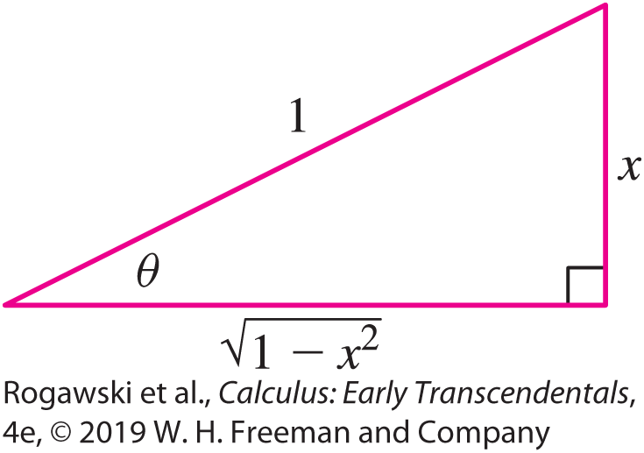

7.3 Trigonometric Substitution (3 of 13)
EXAMPLE: In these two examples, we use the substitution $x= \sin{u} and dx=\cos{u}du$.
a) $\int{\frac{1}{\sqrt{1 − x^{2}}}dx=\int{\frac{1}{\sqrt{1 − \sin^{2 }u}}\cos{u}du} }$
$=\int{\frac{1}{\cos{u}}}\cos{u}du=\int{du}=u+C=\sin^{−1}{x}+C$
b) $\int{\sqrt{1−x^{2}}}dx=\int{\sqrt{1−\sin^{2} u}\cos{u}du}$
$=\int{\cos^{2} u}du=\frac{1}{2}u+\frac{1}{2}\sin{u}\cos{u}+C$
$=\frac{1}{2}\sin^{−1}{x}+\frac{1}{2}x\sqrt{1−x^{2}}+C since x= \sin{u} yields \cos{u}=\sqrt{1−x^{2}}$

Slide 33

7.3 Trigonometric Substitution (4 of 13)
Integrals Involving $\sqrt{a^{2}−x^{2}}$
If $\sqrt{a^{2}−x^{2}}$ occurs in an integral where a > 0, try the substitution (assuming − $\frac{π}{2}$ ≤ θ ≤ $\frac{π}{2}$)
x = a sin θ , dx = a cos θ dθ , $\sqrt{a^{2}−x^{2}}=a\cos{θ}$
This substitution approach can be used with integrands involving (a² − x ²)^{n/2} for any integer n. The following example demonstrates a case with n = 3.

Slide 34
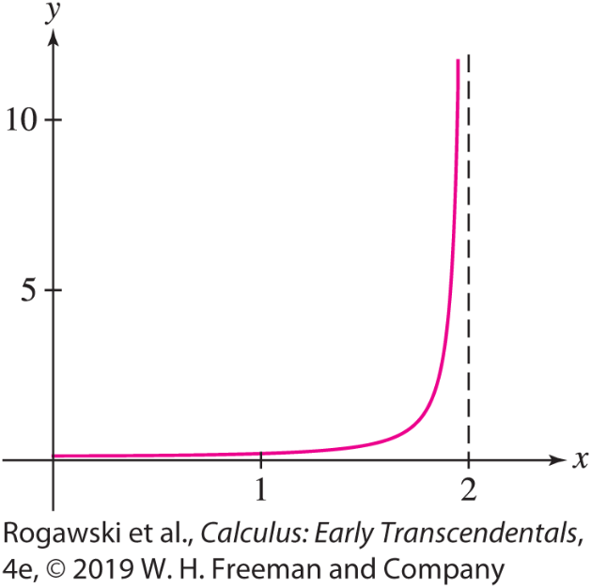

7.3 Trigonometric Substitution (5 of 13)
EXAMPLE: Integrand Involving (a² − x²)^{3/2} The graph of $f\left(x\right)=\frac{1}{{(4 − x^{2})}^{3/2}}$ for x < 2 shown in Figure 2 has a vertical asymptote at x = 2. To find the area under the graph over [0, 1.999], we make the substitution $x=2\sin{θ} a$nd $dx=2\cos{θdθ}$ to find an antiderivative first:
$$\int{\frac{1}{{(4 − x^{2})}^{3/2}}}dx=\int{\frac{2\cos{θ}dθ}{{(4 − \sin^{2}θ)}^{3/2}}}=\int{\frac{2\cos{θ}dθ}{8\cos^{3}{θ}}=\frac{1}{4}\int{\sec^{2}θdθ}}$$

Slide 35
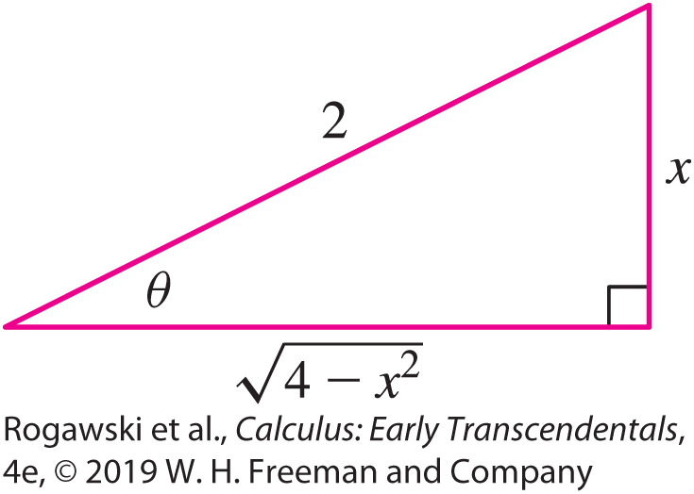

7.3 Trigonometric Substitution (6 of 13)
$$=\frac{1}{4}\tan{θ}+C=\frac{x}{4\sqrt{4−x^{2}}}+C$$
Since x = 2 sin θ , we have sin θ = x/2. Using the triangle in Figure 3 to determine an expression for tan θ , we obtain $\tan{θ}=\frac{x}{\sqrt{4 − x^{2}}}.$
Therefore,
$$\int_{0}^{1.999}{\frac{dx}{{\left(4−x^{2}\right)}^{3/2}}=}\frac{x}{4\sqrt{4−x^{2}}}|_{0}^{1.999}≈7.903$$

Slide 36
7.3 Trigonometric Substitution (7 of 13)
What happens to the area in the previous example if we change the upper limit of the integration, letting the right side of the region approach the asymptote at x = 2?
It turns out that as the upper limit approaches 2, the area gets larger and larger without bound (see Exercises 33 and 34). Interestingly, in contrast to the function in the preceding example, there are functions that become infinite over an interval but the areas under the graphs of these functions are finite. We explore these ideas further in Section 7.7, investigating what are known as improper integrals.

Slide 37

7.3 Trigonometric Substitution (8 of 13)
When the integrand involves $\sqrt{x^{2}+a^{2}}$, try the substitution x = a tan θ , assuming a > 0 and − $\frac{π}{2}$ ≤ θ ≤ $\frac{π}{2}$. Then
$$\sqrt{x^{2}+a^{2}}=\sqrt{a^{2}\tan^{2} θ+a^{2}}=\sqrt{a^{2}\sec^{2} θ}=a\sec{θ}$$
where the last equality holds since a > 0 and since sec θ ≥ 0 for the values of θ involved.
Integrals Involving $\sqrt{x^{2}+a^{2}}$
If $\sqrt{x^{2}+a^{2}}$occurs in an integral where a > 0, try the substitution
x = a tan θ, dx = a sec² θ dθ , $\sqrt{x^{2}+a^{2}}=a\sec{θ}$

Slide 38
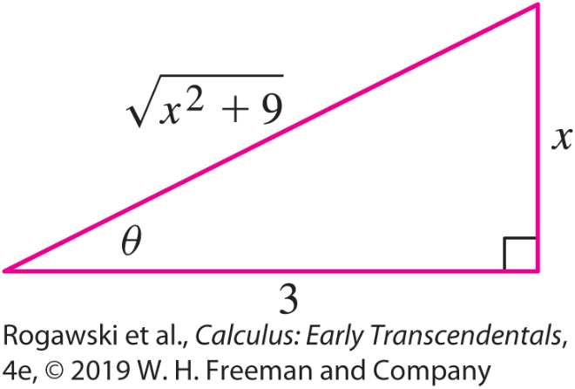

7.3 Trigonometric Substitution (9 of 13)
EXAMPLE: We make the substitution x = 3$\tan{θ}$, $dx=3 \sec^{2}θdθ$:
$$\int{\frac{dx}{\sqrt{x^{2}+9}}=\int{\frac{3\sec^{2}θdθ}{\sqrt{9\tan^{2}θ+9}}}=\int{\frac{3\sec^{2}θdθ}{\sqrt{9 \sec^{2}θ}}}=\int{\sec{θ}}dθ}$$
$$=\ln{|\sec{θ}+\tan{θ}|}+C$$
To convert back, we refer to the triangle and obtain
$$\int{\frac{dx}{\sqrt{x^{2}+9}}}=\ln{|\sec{θ}+\tan{θ}|}+C$$
$$=\ln{|\frac{x}{3}+\frac{\sqrt{x^{2}+9}}{3}|}+C=\ln{|x+ \sqrt{x^{2}+9}|}−\ln{3}+C=\ln{|x+ \sqrt{x^{2}+9}|}+C$$

Slide 39

7.3 Trigonometric Substitution (10 of 13)
Our last substitution addresses the case where the integrand involves $\sqrt{x^{2}−a^{2}}$. In this case, try the substitution x = a sec θ . We assume that a > 0. Furthermore, to ensure the square root is defined, we must have either x ≥ a or x ≤ −a.
In the first case, we assume 0 ≤ θ < $\frac{π}{2}$ in the substitution, and in the second case, we assume π ≤ θ < $\frac{3π}{2}$. These choices for θ guarantee that tan θ is positive in either case, and therefore
$$\sqrt{x^{2}−a^{2}}=\sqrt{a^{2} \sec^{2} θ−a^{2}}=\sqrt{a^{2}\tan^{2 }θ}=a\tan{θ}$$
Integrals Involving $\sqrt{x^{2}−a^{2}}$ If $\sqrt{x^{2}−a^{2}}$occurs in an integral where a > 0, try the substitution (assuming 0 ≤ θ < $\frac{π}{2}$ with x ≥ a , and π ≤ θ < $\frac{3π}{2}$ with x ≤ $−$a):
x = a sec θ , $dx=\sec{θ}\tan{θ}dθ$, $\sqrt{x^{2}−a^{2}}=a\tan{θ}$

Slide 40
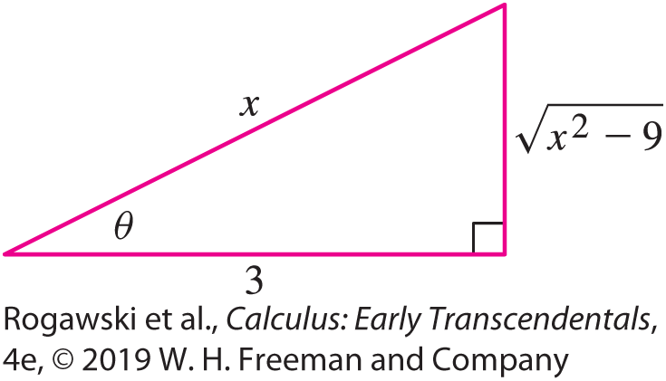

7.3 Trigonometric Substitution (11 of 13)
EXAMPLE: Using the substitution $x=3\sec{θ}$, $dx=\sec{θ}\tan{θ}dθ$ and $\sqrt{x^{2}−9}=3\tan{θ},$ we have
$$\int{\frac{dx}{x^{2}\sqrt{x^{2}−9}}}=\int{\frac{3 sec{θ}\tan{θ}dθ}{(9\sec^{2}θ)(3\tan{θ)}}}=\frac{1}{9}\int{\cos{θ}dθ}$$
$$=\frac{1}{9}\sin{θ}+C$$
$$=\frac{\sqrt{x^{2}−9}}{9x}+C$$

Slide 41

7.3 Trigonometric Substitution (12 of 13)
So far, we have dealt with the expressions $\sqrt{x^{2}±a^{2}}$ and $\sqrt{a^{2}−x^{2}}$. By completing the square (Section 1.2), we can treat the more general form $\sqrt{ax^{2}+bx+c}$.
EXAMPLE: To evaluate $\int{\frac{dx}{{\left(x^{2} + 2x + 3\right)}^{3/2}}}$, we first complete the square:
$$x^{2}+2x+3=x^{2}+2x+1+2={(x+1)}^{2} + 2$$
Substituting u = x + 1 and du = dx, we get
$$\int{\frac{dx}{{\left(x^{2}+2x+3\right)}^{3/2}}}=\int{\frac{du}{{(u^{2}+2)}^{3/2}}}$$

Slide 42

7.3 Trigonometric Substitution (13 of 13)
We now make the trigonometric substitution
$x=\sqrt{2}\tan{θ}$, $dx=\sqrt{2}\sec^{2}θdθ$ and $x^{2}+2=2 \sec^{2}θ$:
$$\int{\frac{du}{{(u^{2}+2)}^{3/2}}}=\int{\frac{\sqrt{2 }\sec^{2}θdθ}{2^{3/2}\sec^{3}θ}}=\frac{1}{2}\int{\cos{θ}dθ}=\frac{1}{2}\sin{θ}+C$$
To convert back to u, observe that$\tan{θ}=\frac{u}{\sqrt{2}}$ yields $\sin{θ}=\frac{u}{\sqrt{u^{2 }+ 2}}=\frac{x + 1}{\sqrt{x^{2} + 2x + 3}}$ since
u = x + 1. Thus,
$$\int{\frac{dx}{{\left(x^{2}+2x+3\right)}^{3/2}}}=\frac{x+1}{2\sqrt{x^{2}+2x+3}}+C$$

Slide 43

7.4 Integrals Involving Hyperbolic and Inverse Hyperbolic Functions (1 of 7)
In Section 1.6, we noted the similarities between hyperbolic and trigonometric functions. We also saw in Section 3.9 that the formulas for their derivatives resemble each other, differing in at most a sign. The derivative formulas for the hyperbolic functions are equivalent to the following integral formulas:
$$\int{\sinh{x}dx}=\cosh{x}+C, \int{\cosh{x}dx}=\sinh{x}+C$$
$$\int{{sech}^{2}xdx}=\tanh{x}+C, \int{{csch}^{2}xdx}=−\coth{x}+C$$
$$\int{\operatorname{sech}{x}\tanh{x}dx}=\operatorname{sech}{x}+C, \int{\operatorname{csch}{x}\coth{x}dx}=−\operatorname{csch}{x}+C$$

Slide 44

7.4 Integrals Involving Hyperbolic and Inverse Hyperbolic Functions (2 of 7)
EXAMPLE: a) The substitution u = x ², du = 2x dx yields
$$\int{x\cosh{x^{2}}dx}=\frac{1}{2}\int{\cosh{u}du}=\frac{1}{2}\sinh{u}+C=\frac{1}{2}\sinh{x^{2}}+C$$
We use the identity cosh² x = sinh² x + 1 and the substitution u = sinh x to evaluate
$$\int{\sinh^{4} x \cosh^{5} xdx}=\int{\sinh^{4} x{(\sinh^{2} x+1)}^{2}\cosh{x}dx}$$
$$=\int{u^{4}{(u^{2}+1)}^{2}du=\int{\left(u^{8}+2u^{6}+u^{4}\right)du}}$$
$$=\frac{1}{9}u^{9}+\frac{3}{7}u^{7}+\frac{1}{5}u^{5}+C=\frac{1}{9}{\text{sinh} \text{x}}^{9}+\frac{3}{7}{\text{sinh} \text{x}}^{7}+\frac{1}{5}{\text{sinh} \text{x}}^{5}+C$$

Slide 45

7.4 Integrals Involving Hyperbolic and Inverse Hyperbolic Functions (3 of 7)
c) We use the identity cosh² x = $\frac{1}{2}($cosh 2x + 1) to evaluate
$$\int{\cosh^{2} xdx=}\frac{1}{2}\int{(\cosh{2x}}+1)dx=\frac{1}{4}\sinh{x}+\frac{1}{2}x+C$$

Slide 46

7.4 Integrals Involving Hyperbolic and Inverse Hyperbolic Functions (4 of 7)
Hyperbolic substitution may be used as an alternative to trigonometric substitution to integrate functions involving the following square root expressions:
$\sqrt{x^{2}+a^{2}}$: x = a sinh u, dx = a cosh u, $\sqrt{x^{2}+a^{2}}=a\cosh{u}$
$\sqrt{x^{2}−a^{2}}$: x = a cosh u, dx = a sinh u, $\sqrt{x^{2}+a^{2}}=a\sinh{u}$

Slide 47

7.4 Integrals Involving Hyperbolic and Inverse Hyperbolic Functions (5 of 7)
EXAMPLE: We use the substitution x = 4sinh u, dx = 4cosh u, $x^{2}+16={(4\cosh{u)}}^{2}$ to evaluate
$$\int{\sqrt{x^{2}+16}dx}=\int{4\cosh{u}}4\cosh{u}du=16\int{\cosh^{2}u}du$$
$$=16\int{\frac{1}{2}(\cosh{2u}+1)}du=4\sinh{2u}+8u+C$$
Since $4\sinh{2u}=8\sinh{u}\cosh{u}=8\sinh{u}\sqrt{\sinh^{2}u+1}=8\frac{x}{4}\sqrt{{\left(\frac{x}{4}\right)}^{2}+1}=\frac{1}{2}x\sqrt{x^{2}+16}$, we have
$$\int{\sqrt{x^{2}+16}dx}=\frac{1}{2}x\sqrt{x^{2}+16}+8\sinh^{−1}\left(\frac{x}{4}\right)+C$$

Slide 48
7.4 Integrals Involving Hyperbolic and Inverse Hyperbolic Functions (6 of 7)
The following integral formulas are derived from the corresponding derivative formulas for the inverse hyperbolic functions given in Section 3.9. Each formula is valid on the domain where the integrand and inverse hyperbolic function are defined.

Slide 49

7.4 Integrals Involving Hyperbolic and Inverse Hyperbolic Functions (7 of 7)
EXAMPLE: a)
$$\int_{2}^{4}{\frac{1}{\sqrt{x^{2}−1}}}dx=\cosh^{−1}{x}|_{2}^{4}≈0.75$$
b) Using the substitution u = x², xdx = $\frac{1}{2}du$, we get
$$\int_{0.2}^{0.6}{\frac{xdx}{1−x^{4}}}=\frac{1}{2}\int_{0.04}^{0.36}{\frac{du}{1−u^{2}}}=\frac{1}{2}\tanh^{−1}{u}|_{0.04}^{0.36}≈0.11684$$

Slide 50

7.5 The Method of Partial Fractions (1 of 23)
The Method of Partial Fractions is used to integrate rational functions: $f\left(x\right)=\frac{P(X)}{Q(X)}$, where P and Q are polynomials. The idea is to write f as a sum of simpler rational functions that can be integrated directly. For example, expressing $\frac{1}{x^{2} − 1}$ as a sum $\frac{(1/2)}{x − 1}−\frac{(1/2)}{x + 1}$ enables us to evaluate the integral
$$\int{\frac{dx}{x^{2}−1}}=\frac{1}{2}\int{\frac{dx}{x −1}}−\frac{1}{2}\int{\frac{dx}{x+1}}=\frac{1}{2}\ln\left|x −1\right|−\frac{1}{2}\ln\left|x+1\right|+C$$
A rational function P/Q is called proper if the degree of P [denoted deg( P)] is less than the degree of Q. For example, $\frac{x^{2}− 4x + 7}{x^{4} − 6}$ is proper, while $\frac{2x^{2}+ 9}{x − 3}$ and $\frac{x − 1}{x + 1}$ are not proper.

Slide 51

7.5 The Method of Partial Fractions (2 of 23)
Suppose first that P/Q is proper and that the denominator Q(x) factors as a product of distinct linear factors. In other words,
$$\frac{P(x)}{Q(x)}=\frac{P(x)}{(x − a_{1})(x−a_{2})⋯(x−a_{n})}$$
where the values a₁, a₂, ... , a_{n} are all distinct and deg( P) < n. Then there is a partial fraction decomposition:
$$\frac{P(x)}{Q(x)}=\frac{A_{1}}{x − a_{1}}+\frac{A_{2}}{x − a_{2}}+⋯+\frac{A_{n}}{x − a_{n}}$$
for suitable constants A₁, ... , A_{n}. For example,
$$\frac{5x^{2}+x−28}{(x+1)(x−2)(x−3)}=−\frac{2}{x+1}+\frac{2}{x−2}+\frac{5}{x−3}$$

Slide 52

7.5 The Method of Partial Fractions (3 of 23)
To obtain a partial fraction decomposition, we must find the constants A₁, ... , A_{n} . There are two different methods that we will employ: Undetermined Coefficients and Value Substitution. Ultimately, the process involves solving a system of linear equations in the constants.
In the examples that follow, given a fraction $\frac{P(x)}{Q(x)}$ , we will see how these methods
can be used to obtain a partial fraction decomposition for $\frac{P(x)}{Q(x)}$. Once we have found the partial
fraction decomposition, we can integrate the individual terms using techniques that we have previously seen.

Slide 53

7.5 The Method of Partial Fractions (4 of 23)
EXAMPLE: We evaluate $\int{\frac{dx}{x^{2}− 7x + 10}}$. Since $x^{2}−7x+10=\left(x −2\right)\left(x−5\right),$ we have
$$\frac{1}{(x−2)(x−5)}=\frac{A}{x −2}+\frac{B}{x−5}$$
To find A and B, first multiply by (x − 2)(x − 5) to clear denominators:
$$1=A\left(x−5\right)+B\left(x−2\right)=\left(A+B\right)x+\left(−5A−2B\right) (2)$$
We will use the method of Undetermined Coefficients to determine the constants. Note that on the left side of Eq. (2), there are no x terms, and on the right side the coefficient of x is A + B. Furthermore, the constant terms are 1 on the left and −5A − 2B on the right. Thus, equating coefficients of like powers of x, we obtain
0 = A + B (coefficient of x )
1 = −5A − 2B (constant terms)

Slide 54

7.5 The Method of Partial Fractions (5 of 23)
The first of these equations implies B = − A. Substituting − A for B in the second
equation and solving for A, we find A = $−\frac{1}{3}$ . It follows that B = $\frac{1}{3}$. The resulting partial fraction decomposition is
$\frac{1}{(x − 2)(x − 5)}=\frac{−(1/3)}{x − 2}+\frac{(1/3)}{x − 5}$
Therefore,
$$\int{\frac{dx}{x^{2}−7x+10}}=−\frac{1}{3}\int{\frac{dx}{x−2}}+\frac{1}{3}\int{\frac{dx}{x−2}}=−\frac{1}{3}\ln\left|x−2\right|+\frac{1}{3}\ln\left|x−5\right|+C$$

Slide 55

7.5 The Method of Partial Fractions (6 of 23)
EXAMPLE: To evaluate $\int{\frac{x^{2}+2}{(x − 1)(2x − 8)(x + 2)}dx}$, we first find the partial sum decomposition:
$$\frac{x^{2}+2}{(x−1)(2x−8)(x+2)}=\frac{A}{x−1}+\frac{B}{2x−8}+\frac{C}{x+2}$$
To clear the denominators, we multiply both sides by $(x−1)(2x−8)(x+2)$ and obtain
$$x^{2}+2=A\left(2x−8\right)\left(x+2\right)+B\left(x−1\right)\left(x+2\right)+C\left(x−1\right)\left(2x−8\right) (4)$$
In this case, we will use Value Substitution to determine the constants. Note that in Eq. (4), the factor x − 1 appears in two terms on the right-hand side. Thus, if we substitute 1 for x in the equation, those terms drop out, leaving us with a simple equation to solve for A. Specifically, substituting x = 1, we obtain
1² + 2 = A(−6)(3) + 0 + 0
Therefore, 3 = −18A, yielding A = $−\frac{1}{6}.$

Slide 56

7.5 The Method of Partial Fractions (7 of 23)
Similarly, substituting 4 for x , the two 2x − 8 terms become 0, providing us with
4² + 2 = 0 + B(3)(6) + 0. From this, we obtain B = 1. Finally, C is determined by setting x = −2 in Eq. (4): (−2)² + 2 = 0 + 0 + C(−3)(−12). Thus, C = $\frac{1}{6}$ , and the resulting partial fraction decomposition is
$$\frac{x^{2}+2}{(x−1)(2x−8)(x+2)}=\frac{−1/6}{x−1}+\frac{1}{2x−8}+\frac{1/6}{x+2}$$
$$\int{\frac{x^{2}+2}{(x−1)(2x−8)(x+2)}}dx=−\frac{1}{6}\int{\frac{dx}{x−1}}+\int{\frac{dx}{2x−8}}+\frac{1}{6}\int{\frac{dx}{x+2}}$$
$$=−\frac{1}{6}\ln\left|x−1\right|+\frac{1}{2}\ln\left|2x−8\right|+\frac{1}{6}\ln\left|x+2\right|+C$$

Slide 57

7.5 The Method of Partial Fractions (8 of 23)
When using Value Substitution to determine the constants, look for values of x that result in equations that are as simple as possible when the values are substituted for x. In the previous example, each constant was obtained directly by substituting an appropriate value for x. This is not always possible, but we can always obtain a system of equations in the constants that can be solved.
Now, what do we do if the denominator has a repeated linear factor? For instance, in the next example, (x + 2)² is a factor of the denominator. In the decomposition, we need to include terms $\frac{A}{x + 2}$ and $\frac{B}{{(x + 2)}^{2}}$.
In general, each factor (x − a)^{n} contributes the following sum of terms to the partial fraction decomposition:
$$\frac{A_{1}}{x −a}+\frac{A_{2}}{{(x −a)}^{2}}+ ⋯ +\frac{A_{n}}{{(x −a)}^{n}}$$

Slide 58

7.5 The Method of Partial Fractions (9 of 23)
EXAMPLE: Repeated Linear Factors We evaluate $\int{\frac{3x − 9}{{\left(x + 2\right)}^{2}(x − 1)}}dx$. We are looking for a partial fraction decomposition of the form
$$\frac{3x − 9}{{\left(x+2\right)}^{2}(x −1)}=\frac{A}{x+2}+\frac{B}{{(x+2)}^{2}}+\frac{C}{x −1}$$
We clear denominators by multiplying both sides by (x + 2)²(x – 1) and obtain
$$3x−9=A\left(x+2\right)\left(x−1\right)+B\left(x−1\right)+C{(x+2)}^{2}$$
We use Value Substitution in this case. As in the previous example, by substituting appropriately, we can obtain single equations that yield values for B and C. We cannot obtain A directly in this manner, but a further substitution provides an equation that can be used to determine A, given the values of B and C.

Slide 59

7.5 The Method of Partial Fractions (10 of 23)
We substitute into Eq. (5) as follows:
Set x = 1. This gives −6 = 9C.
Set x = −2. This gives −15 = −3B.
Set x = 0. This gives −9 = −2 A − B + 4C.
We now have three equations that we can easily solve for A, B, and C. The first two equations yield C = − $\frac{2}{3}$ and B = 5, respectively. With those solutions, we then obtain A = $\frac{2}{3}$ from the third. Therefore, we have
$$\frac{3x − 9}{{\left(x+2\right)}^{2}(x −1)}=\frac{(2/3)}{x+2}+\frac{5}{{(x+2)}^{2}}+\frac{−(2/3)}{x −1}$$

Slide 60

7.5 The Method of Partial Fractions (11 of 23)
$$\int{\frac{3x − 9}{{\left(x+2\right)}^{2}(x −1)}}dx=\frac{2}{3}\int{\frac{dx}{x+2}}+5\int{\frac{dx}{{(x+2)}^{2}}}−\frac{2}{3}\int{\frac{dx}{x−1}}$$
$$=\frac{2}{3}\ln{|x+2|}−\frac{5}{x+2}−\frac{2}{3}\ln\left|x−1\right|+C$$
If P/Q is not proper—that is, if deg( P) ≥ deg(Q)—we use long division to write
$$\frac{P(x)}{Q(x)}=g\left(x\right)+\frac{R(x)}{Q(x)}$$
where g is a polynomial and R/Q is proper. Then integrating P(x)/Q(x) involves evaluating an integral of the polynomial g(x) (which is straightforward) and integrating R(x)/Q(x) via a partial fractions decomposition, if possible.

Slide 61

7.5 The Method of Partial Fractions (12 of 23)
EXAMPLE: Long Division Necessary We evaluate $\int{\frac{x^{3}+ 1}{x^{2} − 4}}dx$. Using long division, we write
$$\frac{x^{3}+1}{x^{2} −4}=x+\frac{4x+1}{x^{2} −4}$$
It is not difficult to show that the second term has a partial fraction decomposition:
$$\frac{4x+1}{x^{2} −4}=\frac{(9/4)}{x −2}+\frac{(7/4)}{x+2}$$
$$\int{\frac{x^{3}+1}{x^{2} −4}}dx=\int{(x+}\frac{(9/4)}{x −2}+\frac{(7/4)}{x+2})dx=\int{xdx}+\frac{9}{4}\int{\frac{dx}{x−2}}+\frac{7}{4}\int{\frac{dx}{x+2}}$$
$$=\frac{1}{2}x^{2}+\frac{9}{4}\ln{|x−2|}+\frac{7}{4}\ln{|x+2|}+C$$

Slide 62

7.5 The Method of Partial Fractions (13 of 23)
A quadratic polynomial x ² + ax + b is called irreducible if it cannot be written as a product of two linear factors (without using complex numbers). If the denominator of a proper rational function has an irreducible quadratic factor (x ² + ax + b)^{M} , then it contributes a sum of the following type to a partial fraction decomposition:
$$\frac{A_{1}x+B_{1}}{ax^{2}+bx+c}+\frac{A_{2}x+B_{2}}{{\left(ax^{2}+bx+c\right)}^{2}}+⋯+\frac{A_{M}x+B_{M}}{{\left(ax^{2}+bx+c\right)}^{M}}$$
For example,
$$\frac{\text{4} \text{−} \text{1}\text{2}\text{x}}{\text{(}\text{x} \text{+} \text{1)}\text{(}\text{x} \text{2} \text{+} \text{x} \text{+} \text{4}\text{)}\text{2}}=\frac{1}{x+1}−\frac{x}{x^{2}+x+4}+\frac{4x+12}{{\left(x^{2}+x+4\right)}^{2}}$$

Slide 63

7.5 The Method of Partial Fractions (14 of 23)
EXAMPLE: Evaluate a) $\int{\frac{18dx}{(x + 3)(x^{2} + 9)}}$ and b) $\int{\frac{18dx}{(x + 3)(x^{2}− 9)}}$.
Since $x^{2}+ 9$ is irreducible, the partial fraction decomposition has the form
$$\frac{18}{(x+3)(x^{2}+ 9)}=\frac{A}{x+3}+\frac{Bx+C}{x^{2}+9}$$
We multiply by (x + 3)($x^{2}+ 9)$ to obtain
$$18=A\left(x^{2}+ 9\right)+(Bx+C)(x+3)$$
We will use Undetermined Coefficients, so we multiply out the right side and then combine terms in like powers of x:
18 = (A + B)x ² + (3B + C)x + 9 A + 3C

Slide 64

7.5 The Method of Partial Fractions (15 of 23)
Now, equating coefficients of like powers of x:
0 = A + B (coefficient of x²)
0 = 3B + C (coefficient of x)
18 = 9A + 3C (constant terms)
Into the third equation, we can substitute A = −B from the first equation and C = −3B from the second equation to obtain 18 = −9B − 9B. This yields B = −1. Now, knowing B = −1, we obtain A = −B = 1 and C = −3B = 3. We can then compute the integral:
$$\int{\frac{18dx}{(x+3)(x^{2}+ 9)}}=\int{(\frac{1}{x+3}+\frac{−x+3}{x^{2}+9})dx}=\int{\frac{dx}{x+3}}−\int{\frac{xdx}{x^{2}+9}}+\frac{1}{3}\int{\frac{dx}{{\left(\frac{x}{3}\right)}^{2}+1}}$$
$$=\ln{|x+3|}+\frac{1}{2}\ln{(x^{2}+9)}+\tan^{−1}\left(\frac{x}{3}\right)+C$$

Slide 65

7.5 The Method of Partial Fractions (16 of 23)
b) The polynomial x ² − 9 is reducible because x ² − 9 = (x − 3)(x + 3). Therefore, the partial fraction decomposition has the form
$$\frac{18}{(x+3)(x^{2}−9)}=\frac{A}{x−3}+\frac{B}{x+3}+\frac{C}{{\left(x+3\right)}^{2}}$$
Clear the denominators:
18 = A(x + 3)² + B(x + 3)(x − 3) + C(x − 3)
We use Value Substitution. The substitutions x = 3 and x = −3 provide equations that yield values for A and C, respectively. An additional substitution (we will use x = 0) results in a third equation that will be used to determine B:
Set x = 3. This gives 18 = 36A.
Set x = −3. This gives 18 = −6C.
Set x = 0. This gives 18 = 9A − 9B − 3C.

Slide 66

7.5 The Method of Partial Fractions (17 of 23)
The solutions are A = $\frac{1}{2}$ , C = −3, and B = − $\frac{1}{2}$. Determining the integral, we find
$$\int{\frac{18}{(x−3)(x^{2}−9)}}dx=\int{(\frac{(1/2)}{x−3}−\frac{(1/2)}{x+3}−\frac{3}{{\left(x+3\right)}^{2}})}dx$$
$$=\frac{1}{2}\ln{|x−3|}−\frac{1}{2}\ln\left|x+3\right|+\frac{3}{x+3}+C$$

Slide 67

7.5 The Method of Partial Fractions (18 of 23)
In the next example, we use both Value Substitution and Undetermined Coefficients to find the partial fractions decomposition. Due to the complexity of the polynomials involved, after Value Substitution determines one constant, Undetermined Coefficients is the best option for determining the remaining ones.
EXAMPLE: For $\int{\frac{4 − x}{x{(x^{2} + 2)}^{2}}dx}$, the partial fraction decomposition is
$$\frac{4−x}{x{(x^{2}+2)}^{2}}=\frac{A}{x}+\frac{Bx+C}{x^{2}+2}+\frac{Dx+E}{{(x^{2}+2)}^{2}}$$
Clear the denominators by multiplying through by x (x ² + 2)²:
4 − x = A(x ² + 2)² + (Bx + C) x (x ² + 2) + (Dx + E )x

Slide 68
7.5 The Method of Partial Fractions (19 of 23)
We compute A directly by setting x = 0. Then Eq. (6) reduces to 4 = 4A, or A = 1. We cannot find the remaining constants as simply as we determined A. The best option is to use Undetermined Coefficients to set up a system of four equations in the four unknowns B, C, D, and E. To begin, we substitute the known value A = 1 in Eq. (6) and expand:
−x = (1 + B)x ⁴ + Cx ³ + (4 + 2B + D)x ² + (2C + E )x
Now equate the coefficients on the two sides of the equation:
0 = 1 + B (coefficient of x ⁴)
0 = C (coefficient of x ³)
0 = 4 + 2B + D (coefficient of x ²)
−1 = 2C + E (coefficient of x )

Slide 69

7.5 The Method of Partial Fractions (20 of 23)
These equations yield B = −1, C = 0, D = −2, and E = −1. Thus,
$$\int{\frac{4−x}{x{(x^{2}+2)}^{2}}dx}=\int{\left(\frac{1}{x}+\frac{−x}{x^{2}+2}+\frac{−2x−1}{{(x^{2}+2)}^{2}}\right)}dx$$
$$=\int{\frac{dx}{x}}−\int{\frac{x}{x^{2}+2}}dx−\int{\frac{2x}{{\left(x^{2}+2\right)}^{2}}}dx−\int{\frac{dx}{{\left(x^{2}+2\right)}^{2}}}$$
We have
$$\int{\frac{1}{x}dx}=\ln{|x|}+C, \int{\frac{x}{x^{2}+2}}dx=\frac{1}{2}\ln{(x^{2}}+2)+C$$
$$\int{\frac{2x}{{\left(x^{2}+2\right)}^{2}}}dx=−\frac{1}{x^{2}+2}+C$$

Slide 70
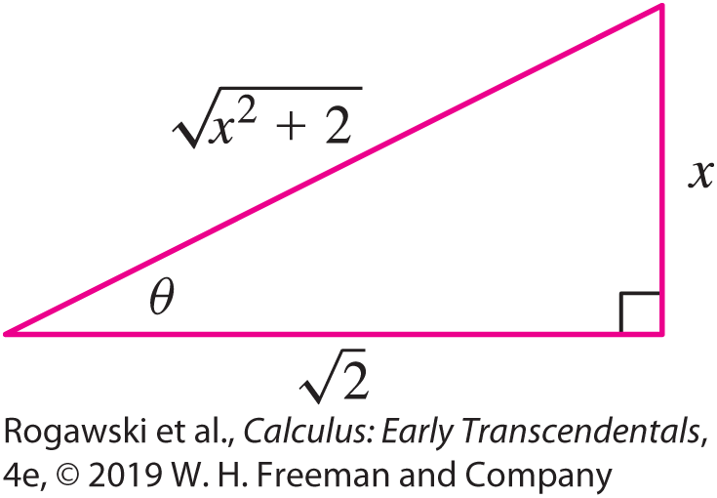

7.5 The Method of Partial Fractions (21 of 23)
To evaluate the last integral, we use the trigonometric substitution x = $\sqrt{2}$ tan θ ,
dx = $\sqrt{2}$ sec² θ dθ , and x ² + 2 = 2 tan² θ + 2 = 2 sec² θ. Referring to Figure 1, we obtain
$\int{\frac{dx}{{\left(x^{2}+ 2\right)}^{2}}}=\int{\frac{\sqrt{2}\sec^{2}θdθ}{4\sec^{4}θ}}=\frac{\sqrt{2}}{4}\int{\cos^{2}θ}dθ=\frac{\sqrt{2}}{4}\left(\frac{1}{2}θ+\frac{1}{2}\sin{θ}\cos{θ}\right)+C$
$=\frac{\sqrt{2}}{8}\tan^{−1}\left(\frac{x}{\sqrt{2}}\right)+\frac{\sqrt{2}}{8}\frac{x}{\sqrt{x^{2}+ 2}}\frac{\sqrt{2}}{\sqrt{x^{2}+ 2}}+C$
$=\frac{\sqrt{2}}{8}\tan^{−1}\left(\frac{x}{\sqrt{2}}\right)+\frac{1}{4}\frac{x}{x^{2}+ 2}+C$

Slide 71

7.5 The Method of Partial Fractions (22 of 23)
Collecting all the terms, we have
$$\int{\frac{4−x}{x{(x^{2}+2)}^{2}}dx}=\ln{|x|}−\frac{1}{2}\ln\left(x^{2}+2\right)+\frac{1−\frac{1}{4}x}{x^{2}+2}−\frac{\sqrt{2}}{8}\tan^{−1}\left(\frac{x}{\sqrt{2}}\right)+C$$

Slide 72
7.5 The Method of Partial Fractions (23 of 23)
At the beginning of this section, we explained in a marginal comment that the Fundamental Theorem of Algebra guarantees that every polynomial can be factored into linear and quadratic terms. This property is simple in theory, but in practice, finding a sum can be difficult. Our challenge is to identify the factors of the denominator. Indeed, sometimes it is not possible to determine the exact factors and, at best, we can only approximate them. To find the numerators in the partial fraction decomposition once the denominator is factored, we can set up and solve a system of linear equations with the constants as unknowns.

Slide 73

7.6 Strategies for Integration (1 of 21)
In Chapter 5, and in the preceding sections of this chapter, we have seen a variety of techniques for evaluating various integrals. However, in the real world, when confronted with a given integral, it will not appear in a particular section devoted to a particular technique of integration. Hence, it is important to be able to recognize which technique of integration is likely to apply. This section is devoted to that topic. In addition to considering how to recognize what technique to apply, we also discuss how tables of integrals and how computer algebra systems can be utilized to find an integral.
In general, there are no hard and fast rules for evaluating a given indefinite integral. But there are various heuristics that help us to determine which techniques are likely to apply.
Given an integral $\int{f(x)}dx$, here are steps that one might apply to try to compute it.

Slide 74

7.6 Strategies for Integration (2 of 21)
Simplification:
$$\int{\frac{x^{3}−1}{x−1}dx}=\int{\frac{(x−1)(x^{2}+x+1)}{x−1}dx}=\int{(x^{2}+x+1)}dx=\frac{1}{3}x^{3}+\frac{1}{2}x^{2}+x+C$$
$$\int{\frac{x−x^{3}}{\sqrt{x}}}dx=\int{(x^{1/2}−}x^{5/2})dx=\frac{2}{3}x^{3/2}−\frac{2}{7}x^{7/2}+C$$
$$\int{\frac{1}{\sin^{2}x}}dx=\int{\csc^{2}x}dx=−\csc{x}+C$$
$\int{e^{x}\sinh{x}dx}$: It is tempting to try to apply Integration by Parts to this integral, but this method does not work.
$$\int{e^{x}\sinh{x}dx}=\int{e^{x}\frac{e^{x}−e^{−x}}{2}}dx=\frac{1}{2}\int{\left(e^{2x}−1\right)dx}=\frac{1}{4}e^{2x}−\frac{1}{2}x+C$$

Slide 75

7.6 Strategies for Integration (3 of 21)
Substitution: Any time we recognize that our integral is of the form $\int{f\left(g\left(x\right)\right)g^{′}\left(x\right)dx}$, we can use substitution. The key to successfully substituting is that if we want to replace g(x) by u, we need a $g′(x)$ to appear in the integrand in such a way that we can pair with dx to obtain the necessary du.
So, for example, $\int{\text{x} \text{2} \text{sin}\text{(}\text{x} \text{3}\text{)} \text{d}\text{x}}$ is set up for substitution since if we let u = x ³, then du = 3x ² dx , and we have the requisite x ²dx to make this work. We simply substitute (1/3)du for x ²dx , and we will obtain an integral that we then can compute.
In the case of $\int{\text{e}\text{sin} \text{x} \text{co}\text{s} \text{x} \text{d}\text{x}}$, we can use u = sin x and du = cos x dx .
In the case of$\int{e^{x}\sqrt{e^{x}+1}dx}$, we can let u = e^{x} + 1 and then du = e^{x}dx , which we have.
Sometimes, some extra algebraic work is needed to carry out a substitution so that all of the x terms are changed to terms in the new variable u.

Slide 76

7.6 Strategies for Integration (4 of 21)
EXAMPLE: We find $\int{x^{3}\sqrt{x^{2}+1}dx}$. Our first inclination is to try the substitution u = 1 + x² since that quantity is inside the square root. But then du = 2x dx , and we have an extra factor of x² left over. Instead of turning to another method of integration, though, we can note that since u = 1 + x ², x ² = u − 1. Thus, we have
$$\int{x^{3}\sqrt{x^{2}+1}dx}=\frac{1}{2}\int{(u−1)\sqrt{u}}du=\frac{1}{2}\int{\left(u^{3/2}−u^{1/2}\right)du}$$
$$=\frac{1}{5}u^{5/2}−\frac{1}{3}u^{3/2}+C=\frac{1}{5}{\left(x^{2}+1\right)}^{5/2}−\frac{1}{3}{\left(x^{2}+1\right)}^{3/2}+C$$
This integral could also be evaluated using Integration by Parts, but that would be more work.

Slide 77

7.6 Strategies for Integration (5 of 21)
Integration by Parts: As we have seen, if there is a product in the integrand, we can split the integral into two pieces u and dv and then apply Integration by Parts to obtain
$$\int{udv=uv−\int{vdu}}$$
For example, look at $\int{\text{x}\text{e}\text{x}}dx$. In this case, it is obvious that Integration by Parts applies. If the x were not present, we could easily integrate e^{x}. So choosing u = x and dv = e^{x} dx will yield $\int{xe^{x}dx}=xe^{x}−\int{e^{x}dx}$. The remaining integral is now one we can compute.
In particular, we are looking for integrands that are products such that differentiating one term in the product and integrating the other yields an integral that is easier to evaluate. Here are some cases to look for:

Slide 78

7.6 Strategies for Integration (6 of 21)
$\int{\text{x}\text{n}\text{f} \text{(}\text{x}\text{)} \text{d}\text{x}}$. Assuming f (x) can be repeatedly integrated, we may use repeated applications of Integration by Parts, always choosing u equal to the remaining power of x, until we eliminate the powers of x, leaving something we can integrate. Candidates for f (x) include sin x, cos x, e^{x}, a^{x}, sinh x, cosh x, sec² x, and csc² x, among others. Note that the same technique applies when we replace x^{n} in the integrand with a more complicated polynomial. Repeated application of Integration by Parts can be used to eliminate the polynomial.
$\int{e^{x}\sin{xdx}}$. Two applications of Integration by Parts, choosing u = e^{x} both times, yields
$$\int{e^{x}\sin{x}dx}=−e^{x}\cos{x}+e^{x}\sin{x}−\int{e^{x}\sin{x}dx}$$

Slide 79

7.6 Strategies for Integration (7 of 21)
Instead of obtaining a simpler integral on the right, we obtained the exact same integral we started with on the left. Adding it to both sides, we get
$$2\int{e^{x}\sin{x}dx}=−e^{x}\cos{x}+e^{x}\sin{x}$$
$$\int{e^{x}\sin{x}dx}=−\frac{1}{2}e^{x}\cos{x}+\frac{1}{2}e^{x}\sin{x}+C$$
3. In some special cases, we can use Integration by Parts for $\int{f\left(x\right)dx}$ by setting u = f (x) and dv = dx . For example, this works with the integrals $\int{\ln{x}dx}$, $\int{\tan^{−1}{x}dx}$ and $\int{\sin^{−1}{x}dx}$.

Slide 80

7.6 Strategies for Integration (8 of 21)
Sometimes Integration by Parts is easier if we integrate, rather than differentiate, the x^{n} - factor, as in the next example.
EXAMPLE: To compute $\int{x^{2}\ln{x}dx}$, we proceed as follows:
$$u=\ln{x}, du=\frac{1}{x}dx, dv=x^{2}dx, v=\frac{1}{3}x^{3}$$
$$\int{x^{2}\ln{x}dx}=\frac{1}{3}x^{3}\ln{x}−\int{\frac{1}{3}x^{3}\frac{1}{x}dx}=\frac{1}{3}x^{3}\ln{x}−\frac{1}{3}\int{x^{2}}dx$$
$$=\frac{1}{3}x^{3}\ln{x}−\frac{1}{9}x^{3}+C.$$
For the previous example, using u = x² and dv = ln x dx also works, but this alternative is more complicated than the choice we used (see Exercise 60).

Slide 81

7.6 Strategies for Integration (9 of 21)
Special Techniques: Consider the form of the integral. Does it fall into one of the categories for which we have a special technique?
Is it a trigonometric integral? If it is of the form
$$\int{\sin^{n} x \cos^{m} x}dx or \int{\tan^{n} x \sec^{m} x}dx$$
then we have specific rules that can be applied (as outlined in Section 7.2) to simplify the integral into one that can be computed.

Slide 82

7.6 Strategies for Integration (10 of 21)
2. Does the integrand contain (a² − x²)^{n/2}, (x² + a²)^{n/2}, or (x² − a²)^{n/2} for an integer n? If so, then try a trigonometric substitution, x = a sin θ , x = a tan θ , or x = a sec θ , respectively, as outlined in Section 7.3.
EXAMPLE: We evaluate $\int{\text{(}\text{x} \text{2} \text{+} \text{16}\text{)}\text{3}\text{/}\text{2} \text{d}\text{x}}$. If x = 4 tan θ , then dx = 4 sec² θ dθ and
(x ² + 16)^{3/2} = (16 tan² θ + 16)^{3/2} = (16 sec² θ )^{3/2} = 64 sec³ θ
Hence, we have
$$\int{\text{(}\text{x} \text{2} \text{+} \text{16}\text{)}\text{3}\text{/}\text{2} \text{d}\text{x}}=\int{64 \sec^{3}θ\left(4 \sec^{2}θ\right)dθ}=256\int{\sec^{5 }θdθ}$$

Slide 83

7.6 Strategies for Integration (11 of 21)
Now, we can repeatedly use the reduction formula in Eq. (15) from Section 7.2 to obtain
$$256\int{\sec^{5}θdθ}=\text{6}\text{4} \text{ta}\text{n} \text{θ} \text{sec}\text{3} \text{θ} \text{+} \text{9}\text{6} \text{ta}\text{n} \text{θ} \text{sec} \text{θ} \text{+} \text{96} \text{ln} \text{|} \text{sec} \text{θ} \text{+} \text{tan} \text{θ} \text{|}\text{+} \text{C}$$
Since x = 4 tan θ , we know tan θ = $\frac{x}{4}$, and, by the triangle in Figure 1, sec θ = $\frac{\sqrt{x^{2}+ 16}}{4}$. Thus, we have
$$\int{\text{(}\text{x} \text{2} \text{+} \text{16}\text{)}\text{3}\text{/}\text{2} \text{d}\text{x}}=64\frac{x}{4}\frac{{\left(x^{2}+16\right)}^{3/2}}{64}+96\frac{x}{4}\frac{\sqrt{x^{2}+16}}{4}+96\ln{|\frac{x}{4}+\frac{\sqrt{x^{2}+16}}{4}|}+C$$
$$=\frac{1}{4}x{\left(x^{2}+16\right)}^{3/2}+\frac{1}{6}x\sqrt{x^{2}+16}+96\ln{|x+\sqrt{x^{2}+16}|}+C$$

Slide 84

7.6 Strategies for Integration (12 of 21)
If the integral contains an expression of the form $\sqrt{\text{a}\text{x} \text{2} \text{+} \text{b}\text{x} \text{+} \text{c}}$, we can complete
the square inside the square root in order to obtain one of the cases discussed earlier.
3. Is it a rational function $\frac{P}{Q}$ for polynomials P and Q? If so, we can often apply the method of partial fractions. First, if P has a degree that is at least as large as the degree of Q, we divide P(x) by Q(x) to obtain a polynomial (which is easily integrated) together with a remainder term $\frac{R(x)}{Q(x)}$ to which the method of partial fractions can be applied.

Slide 85

7.6 Strategies for Integration (13 of 21)
EXAMPLE: We find $\int{\frac{x^{2}+ 2x + 10}{x^{2}+ x − 6}dx}$.
Noting that both the numerator and the denominator have degree 2, we divide to obtain $\frac{x^{2}+ 2x + 10}{x^{2}+ x − 6}=1+$ $\frac{x + 16}{x^{2}+ x − 6}$
Since $x^{2}+x−6=(x+3)(x−2)$, we can write
$$\frac{x+16}{x^{2}+x−6}=\frac{A}{x+3}+\frac{B}{x−2}$$

Slide 86

7.6 Strategies for Integration (14 of 21)
Clearing the denominator, we get x + 16 = A(x − 2) + B(x + 3).
We use Value Substitution to determine A and B.
Substituting x = 2 yields 18 = 5B, that is, $B=\frac{18}{5}$. Furthermore, substituting x = −3 results in the equation 13 = −5A, implying $A=−\frac{13}{5}$. Therefore,
$$\int{\frac{x^{2}+2x+10}{x^{2}+x−6}dx}=\int{\left(1−\frac{13}{5}\frac{1}{x+3}+\frac{18}{5}\frac{1}{x−2}\right)dx}$$
$$=x−\frac{13}{5}\ln\left|x+3\right|+\frac{18}{5}\ln\left|X−2\right|+C$$

Slide 87

7.6 Strategies for Integration (15 of 21)
Integral Table: Integral tables (such as the one on the final three pages of this text) contain a list of forms of many common integrals. Given a particular integral that we may want to evaluate, if we can get it into the form of one of the integrals in a table, then we can apply the given formula to evaluate the integral. Let’s consider a couple of examples:
To evaluate $\int{\frac{\sqrt{9 − 4x^{2}}}{x}dx}$, we consider the list of integrals given at the end of the text, and see the formula that appears to apply here is 69:
$\int{\frac{\sqrt{a^{2}−{ u}^{2}}}{u}}du=\sqrt{a^{2}−u^{2}}−a\ln\left|\frac{a+\sqrt{a^{2}− u^{2}}}{u}\right|+C$
We can put our integral in the correct form by factoring the 4 out of the square root:
$\sqrt{9−4x^{2}}=2\sqrt{{(\frac{3}{2})}^{2}−x^{2}}$

Slide 88

7.6 Strategies for Integration (16 of 21)
Now we use formula 69 with $a=\frac{3}{2}$:
$$\int{\frac{\sqrt{9 −4x^{2}}}{x}dx}=2\int{\frac{\sqrt{9/4−x^{2}}}{x}dx}=2\sqrt{9/4 −x^{2}}−\frac{3}{2}\ln\left|\frac{3/2+\sqrt{9/4−x^{2}}}{x}\right|+C$$
Notice that the integral in the previous example could also be evaluated by applying a trigonometric substitution. In fact, many of the formulas in the integral table result from integral techniques and formulas that we have developed.

Slide 89

7.6 Strategies for Integration (17 of 21)
EXAMPLE: We evaluate $\int{\text{6}\text{x} \text{tan}\text{2} \text{(}\text{x} \text{2}\text{)} \text{d}\text{x}}$. The integral table formula that seems applicable is 36: $\int{\tan^{2} udu=\text{tan} \text{u} \text{−} \text{u} \text{+} \text{C}}$. Although the integrand does not have the form in this formula, observe that a substitution u = x ² will put us in a position to use formula 36.
With this substitution, we have du = 2xdx , so 3du = 6xdx . Therefore,
$$\int{\text{6}\text{x} \text{tan}\text{2} \text{(}\text{x} \text{2}\text{)} \text{d}\text{x}}=3\int{\tan^{2} udu}=3\tan{u}−3u+C=3\tan{x^{2}}−3x^{2}+C$$

Slide 90

7.6 Strategies for Integration (18 of 21)
Computer Algebra System: In order to find these last integrals using an integral table, we needed to do some algebra or apply some integration techniques to get them to match the pattern for one of the formulas at the back of the book. Computers are particularly adept at attempting various rearrangements and integration techniques and then matching the resulting integrals. For this reason, computer algebra systems are very good at evaluating integrals.
However, keep in mind that the output that they generate may not be the form that is the most convenient to use. For example, to find $\int{\text{x} \text{(}\text{x} \text{−} \text{3}\text{)}\text{15} \text{d}\text{x}}$, we do the substitution for u = x − 3 (and therefore x = u + 3) and obtain
$$\int{\text{x} \text{(}\text{x} \text{−} \text{3}\text{)}\text{15} \text{d}\text{x}}=\int{\left(u^{16}+3u^{15}\right)}=\frac{1}{17}u^{17}+\frac{3}{16}u^{16}+C$$
$$=\frac{1}{17}{(x−3)}^{17}+\frac{3}{16}{(x−3)}^{16}+C$$

Slide 91
7.6 Strategies for Integration (19 of 21)
On the other hand, the following answer was obtained from a computer algebra system:
As you can see, the answer that we obtained by substitution is simpler to state and would be more convenient to use in computations.

Slide 92
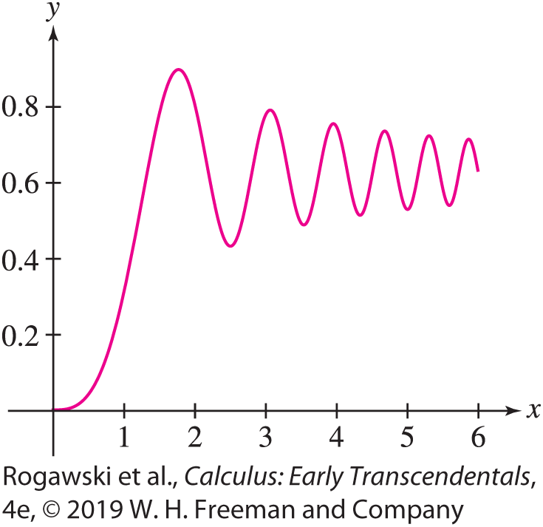

7.6 Strategies for Integration (20 of 21)
Numerical Approximation: If the integral is a definite integral, and finding an antiderivative is difficult or impossible, then the integral can be approximated numerically. One approach would be to use an approximating Riemann sum. Other numerical methods are introduced in Section 7.8.
EXAMPLE: The Fresnel function S(x ) = $S\left(x\right)=\int_{0}^{x}{\sin{{(t}^{2})}dt}$
(Figure 2) is important in the field of optics. It has a maximum
at x = $\sqrt{π}$[the least positive x at which $S^{′}\left(x\right)$ = 0]. Approximate
the maximum value of S.

Slide 93

7.6 Strategies for Integration (21 of 21)
Solution We need to approximate $\int_{0}^{\sqrt{π}}{\sin{{(t}^{2})}dt}$. Note that we cannot evaluate this definite integral via antidifferentiation since there is no antiderivative of f (t ) = sin(t ²) that can
be expressed in terms of elementary functions. Using technology to compute an approximating Riemann sum with 1000 subintervals, we obtain
$$S\left(\sqrt{π}\right)=\int_{0}^{\sqrt{π}}{\sin{(t^{2})}dt}≈0.895$$

Slide 94
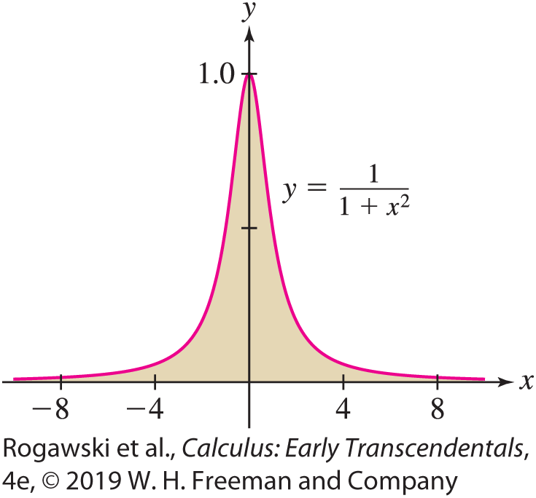

7.7 Improper Integrals (1 of 25)
The integrals we have studied so far represent signed areas of bounded regions. However, we also wish to consider unbounded regions, such as the region under the graph of $y=\frac{1}{1 + x^{2}}$ for −∞ < x < ∞, shown in Figure 1.
Integrals over such regions arise in applications and are represented by what are known as improper integrals.

Slide 95

7.7 Improper Integrals (2 of 25)
There are two ways an integral can be improper: (1) The interval of integration is infinite or (2) the integrand tends to infinity on a finite interval, and therefore the graph of the function has a vertical asymptote. We deal first with improper integrals over infinite intervals. One or both endpoints may be infinite:
$$\int_{−∞}^{a}{f\left(x\right)dx},\int_{a}^{∞}{f\left(x\right)dx},\int_{−∞}^{∞}{f\left(x\right)dx}$$
How can an unbounded region have finite area? To answer this question, we must specify what we mean by the area of an unbounded region. Consider the area [Figure 2(A)] under the graph of f (x) = e^{−x} over the finite interval [0, R]:
$$\int_{0}^{R}{e^{−x}dx}=−e^{−R}+1→1 as R→∞$$

Slide 96
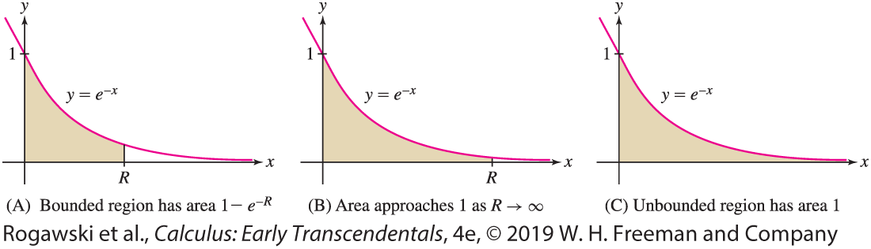
7.7 Improper Integrals (3 of 25)
It seems reasonable to take this limit as the definition of the area under the graph over the infinite interval [0, ∞). Thus, the unbounded region in Figure 2(C) has area 1.

Slide 97

7.7 Improper Integrals (4 of 25)
DEFINITION: Improper Integral Fix a number a and assume that f is integrable over the intervals [a, b] for all b > a. The improper integral of f over [a, ∞) is defined as the following limit (if it exists):
$$\int_{a}^{∞}{f\left(x\right)dx}=\lim_{R→∞}{\int_{a}^{R}{f\left(x\right)dx}}$$
We say that the improper integral converges if the limit exists and that it diverges if the limit does not exist.
Similarly, we define
$$\int_{−∞}^{a}{f\left(x\right)dx}=\lim_{R→−∞}{\int_{R}^{a}{f\left(x\right)dx}}$$

Slide 98
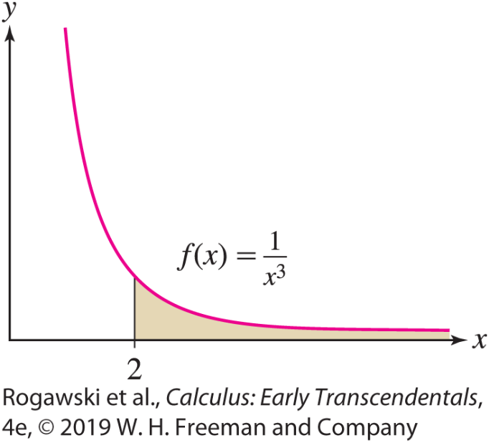
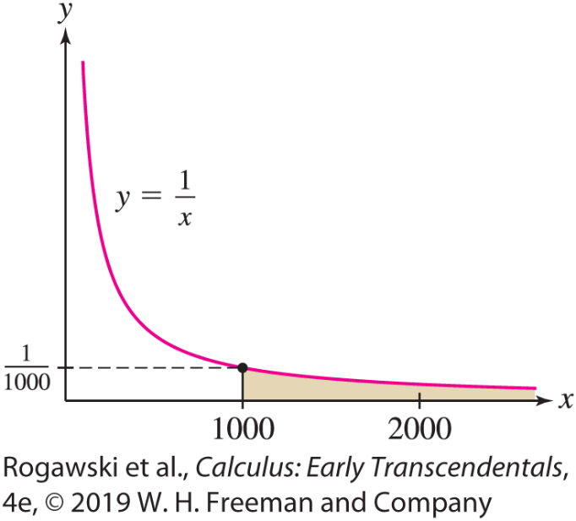

7.7 Improper Integrals (5 of 25)
EXAMPLE:
$\int_{2}^{∞}{\frac{dx}{x^{3}}}=\lim_{R→∞}{\int_{2}^{R}{\frac{dx}{x^{3}}}}=\lim_{R→∞}−\frac{1}{2x^{2}}|_{2}^{R}=\lim_{R→∞}\left(\frac{1}{8}−\frac{1}{R^{2}}\right)=\frac{1}{8}.$ We conclude that the unbounded shaded region in Figure 3 has area $\frac{1}{8}.$
$\int_{1000}^{∞}{\frac{dx}{x}}=\lim_{R→∞}\int_{1000}^{R}{\frac{dx}{x}}=\lim_{R→∞}\left(\ln{R}−\ln{1000}\right)=∞.$ The limit is infinite, so the improper integral diverges. We conclude that the area of the unbounded region in Figure 4 is infinite.
Note that in the previous example, even though f (x ) = 1/x is less than 0.001 in (1000, ∞) and is decreasing to 0, the area under the graph is infinite. Such is the somewhat perplexing nature of improper integrals.

Slide 99

7.7 Improper Integrals (6 of 25)
THEOREM: The p-Integral over [a, ∞) For a > 0,
$$\int_{a}^{∞}{\frac{dx}{x^{p}}}=\left\{\begin{aligned}\begin{matrix} \frac{a^{1−p}}{p−1} & if p>1\end{matrix} \\ \begin{matrix}diverges & if p≤1\end{matrix}\end{aligned}\right.$$
Proof: The case p = 1 was considered in the last example. Therefore, we assume p ≠ 1.
$$J=\int_{a}^{∞}{\frac{dx}{x^{p}}}=\lim_{R→∞}{\int_{a}^{R}{\frac{dx}{x^{p}}}}=\lim_{R→∞}\left(\frac{x^{1−p}}{1−p}\right)\left|\begin{matrix}R \\ a\end{matrix}\right.=\lim_{R→∞}\left(\frac{R^{1−p}}{1−p}−\frac{a^{1−p}}{1−p}\right).$$
If p > 1, then 1 − p < 0 and R^{1− p} tends to zero as R → ∞. In this case, $J=\frac{a^{1−p}}{p−1}.$
If p < 1, then 1 − p > 0 and R^{1− p} tends to ∞. In this case, J diverges.

Slide 100
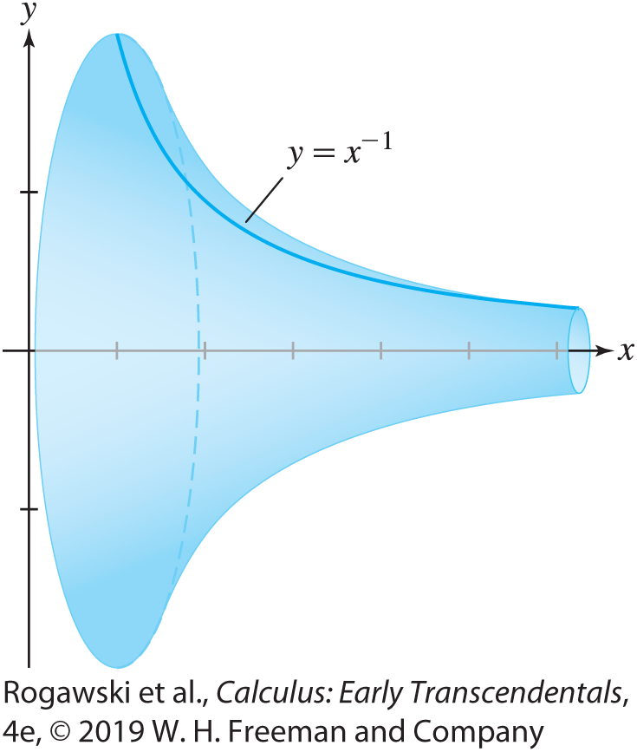

7.7 Improper Integrals (7 of 25)
EXAMPLE: Gabriel’s Horn is the surface obtained by rotating the graph of f (x) = $\frac{1}{x}$ for x ≥ 1 about the x -axis (Figure 5). This surface is interesting because it contains a finite volume but has an infinite surface area. (We verify the latter fact in Section 8.2.) Compute the volume contained in Gabriel’s Horn. We find the volume by the Disk Method from Section 6.3 where the radius of the disk is r = f (x) = $\frac{1}{x}.$ Using the last theorem with a = 1 and p = 2, we obtain
$$volume=π\int_{1}^{∞}{r^{2}dx}=π\int_{1}^{∞}{\frac{1}{x^{2}}dx}=π∙1=π$$
Therefore, the volume contained in Gabriel’s Horn is π.

Slide 101

7.7 Improper Integrals (8 of 25)
A doubly infinite improper integral is defined as a sum (provided that both integrals on the right converge):
$$\int_{−∞}^{∞}{f\left(x\right)dx}=\int_{−∞}^{0}{f\left(x\right)dx}+\int_{0}^{∞}{f(x)}dx$$
We can use some number other than 0 as a choice of where to split the integral if it is more convenient to do so.

Slide 102

7.7 Improper Integrals (9 of 25)
EXAMPLE: We consider $\int_{−∞}^{∞}{\frac{dx}{1 + x^{2}}}.$
$\int_{0}^{R}{\frac{dx}{1 + x^{2}}}=\tan^{−1}{x}|_{0}^{R}=\tan^{−1}{R}→\frac{π}{2} as R→∞.$ Thus, $\int_{0}^{∞}{\frac{dx}{1 + x^{2}}}=\frac{π}{2}$
Similarly, $\int_{R}^{0}{\frac{dx}{1 + x^{2}}}=\tan^{−1}{x}|_{R}^{0}={−tan}^{−1}{R}→\frac{π}{2} as R→−∞$.
Thus, $\int_{−∞}^{∞}{\frac{dx}{1 + x^{2}}}=\frac{π}{2}+\frac{π}{2}=π.$

Slide 103

7.7 Improper Integrals (10 of 25)
EXAMPLE: Using L’Hôpital’s Rule Calculate $\int_{0}^{∞}{xe^{−x}}dx.$
Using Integration by Parts,
$$\int_{0}^{R}{xe^{−x}dx}=−xe^{−x}|_{0}^{R}+\int_{0}^{R}{e^{−x}dx}=−Re^{−R}−e^{R}+1$$
By L’Hôpital’s Rule, $\lim_{R→∞}{\frac{R}{e^{R}}}=\lim_{R→∞}{\frac{1}{e^{R}}}=0.$ Therefore, $\int_{0}^{∞}{xe^{−x}}dx=\lim_{R→∞}{\int_{0}^{R}{xe^{−x}dx}}=1.$

Slide 104
7.7 Improper Integrals (11 of 25)
Improper integrals arise in applications when it makes sense to treat certain large quantities as if they were infinite. In the next example, we determine the escape velocity of an object launched from Earth by assuming that the velocity is sufficient to take it “infinitely far” into space.
EXAMPLE: Escape Velocity The earth exerts a gravitational force of magnitude
F (r) = GM_{e}m/r ² on an object of mass m at distance r from the center of the earth. Find the work required to move the object infinitely far from the earth. Calculate the escape velocity v_{esc} on the earth’s surface.

Slide 105

7.7 Improper Integrals (12 of 25)
Solution This amounts to computing a p-integral with p = 2. Recall that work is the integral of force as a function of distance (Section 6.5).
The work required to move an object from the earth’s surface (r = r_{e}) to a distance R from the center is
$$\int_{r_{e}}^{R}{\frac{\text{G}\text{M}\text{e}\text{m}}{r^{2}}}dr=−\frac{\text{G}\text{M}\text{e}\text{m}}{r}|_{r_{e}}^{R}=\text{G}\text{M}\text{e}\text{m}\left(\frac{1}{r_{e}}−\frac{1}{R}\right)→\frac{\text{G}\text{M}\text{e}\text{m}}{r_{e}} as R→∞$$
The work moving the object “infinitely far away” is $\frac{\text{G}\text{M}\text{e}\text{m}}{r_{e}}$ joules.

Slide 106

7.7 Improper Integrals (13 of 25)
By the principle of Conservation of Energy, an object launched with velocity v₀ will escape the earth’s gravitational field if its kinetic energy $\frac{1}{2}mv_{0}^{2}$ is at least as large as the work required to move the object to infinity—that is, if
$\frac{1}{2}mv_{0}^{2}≥\frac{\text{G}\text{M}\text{e}\text{m}}{r_{e}} and v_{0}≥\sqrt{\frac{\text{2}\text{G}\text{M}\text{e}}{r_{e}}}$
Using the known values for r_{e} and M_{e}, we find that v₀ ≥ 11,200 m/s. The minimal velocity is the escape velocity v_{esc} = 11,200 m/s.

Slide 107

7.7 Improper Integrals (14 of 25)
EXAMPLE: Present Value of Future Income If an investment pays a dividend continuously at a rate of R(t) $/year and earns interest at rate r (in decimal form), then the present value of the dividend income, for the period from t = 0 to t = T, is given by
$PV=\int_{0}^{T}{R\left(t\right)e^{−rt}dt}$
We think of the present value as the payment that we would need to receive at t = 0 so that the payment’s value would be the same as the amount accumulated from the dividend income (with both accumulating interest) at time T.
Assuming that the dividend rate is $6000/year, and the interest rate is 4%, we compute the present value if the dividends continue forever. Over an infinite time interval,
$$PV=\int_{0}^{∞}{6000e^{−0.04t}dt=}\lim_{T→∞}{\frac{6000e^{−0.04t}}{−0.04}}|_{0}^{T}=\frac{6000}{0.004}=150,000$$

Slide 108
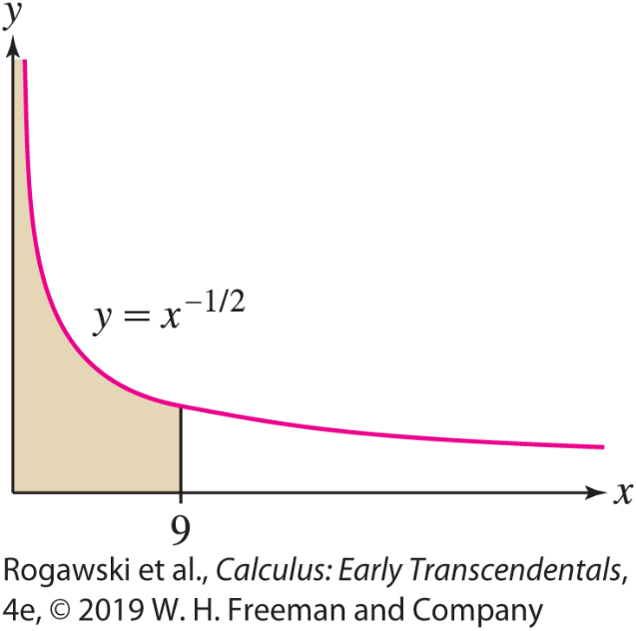

7.7 Improper Integrals (15 of 25)
An integral over a finite interval [a, b] is improper if the integrand is unbounded. In this case, the region in question is unbounded in the vertical direction. For example, $\int_{0}^{9}{\frac{dx}{\sqrt{x}}}$ is improper because the integrand f (x ) = x ^{−1/2} tends to ∞ as x → 0⁺ (Figure 7). Improper integrals of this type are defined as one-sided limits.

Slide 109

7.7 Improper Integrals (16 of 25)
DEFINITION: Unbounded Integrands
If f is continuous on [a, b) and $\lim_{x→b^{−}}{f(x)}=±∞$, then we define
$$\int_{a}^{b}{f(x)}dx=\lim_{R→b^{−}}{\int_{a}^{R}{f(x)}dx}$$
Similarly, if f is continuous on (a, b] and $\lim_{x→a^{+}}{f(x)}=±∞$, we define
$$\int_{a}^{b}{f(x)}dx=\lim_{R→a^{+}}{\int_{R}^{b}{f(x)}dx}$$
In both cases, we say that the improper integral converges if the limit exists and that it diverges otherwise.

Slide 110

7.7 Improper Integrals (17 of 25)
Note that if there is a single point c in the interval [a, b] such that $\lim_{x→c^{−}}{f(x)}=±∞$, or $\lim_{x→c^{+}}{f(x)}=±∞$, and if $\int_{a}^{c}{f(x)}dx$ and $\int_{c}^{b}{f(x)}dx$ both converge, then we define
$$\int_{a}^{b}{f(x)}dx=\int_{a}^{c}{f(x)}dx+\int_{c}^{b}{f\left(x\right)dx}$$

Slide 111

7.7 Improper Integrals (18 of 25)
EXAMPLE: We calculate (a) $\int_{0}^{9}{\frac{dx}{\sqrt{x}}}$ and (b) $\int_{0}^{1/2}{\frac{dx}{x}}$. Both integrals are improper because the integrands have infinite discontinuities at x = 0.
a) The first integral converges:
$$\int_{0}^{9}{\frac{dx}{\sqrt{x}}}=\lim_{R→0^{+}}{2\sqrt{x}}|_{R}^{9}=\lim_{R→0^{+}}{(6−2\sqrt{R})}=6$$
The second integral diverges:
$$\int_{0}^{1/2}{\frac{dx}{x}}=\lim_{R→0^{+}}{\ln{x}}|_{R}^{1/2}=\lim_{R→0^{+}}{(\ln{\frac{1}{2}−\ln{R})=∞}}$$

Slide 112

7.7 Improper Integrals (19 of 25)
EXAMPLE: $\int_{0}^{2}{\frac{dx}{{(x − 1)}^{2/3}}}$ is improper with an infinite discontinuity at x = 1.
$$\int_{0}^{1}{\frac{dx}{{(x−1)}^{2/3}}}=\lim_{R→1^{−}}{\int_{0}^{R}{\frac{dx}{{(x−1)}^{2/3}}}}=\lim_{R→1^{−}}{3{(x−1)}^{1/3}|_{0}^{R}}=\lim_{R→1^{−}}{(3{\left(R−1\right)}^{1/3}+3)}=3$$
$$\int_{1}^{2}{\frac{dx}{{(x−1)}^{2/3}}}=\lim_{R→1^{+}}{\int_{R}^{2}{\frac{dx}{{(x−1)}^{2/3}}}}=\lim_{R→1^{+}}{3{(x−1)}^{1/3}|_{R}^{2}}=\lim_{R→1^{−}}{(3−3{(R−1)}^{1/3})}=3$$
Therefore,
$$\int_{0}^{2}{\frac{dx}{{(x−1)}^{2/3}}}=\int_{0}^{1}{\frac{dx}{{(x−1)}^{2/3}}}+\int_{1}^{2}{\frac{dx}{{(x−1)}^{2/3}}}=3+3=6$$

Slide 113

7.7 Improper Integrals (20 of 25)
The proof of the next theorem is similar to the proof of Theorem 1 (see Exercise 52).
THEOREM: The p-Integral over [0, a] For a > 0,
$$\int_{0}^{a}{\frac{dx}{x^{p}}}=\left\{\begin{aligned}\begin{matrix} \frac{a^{1−p}}{1−p} & if p<1\end{matrix} \\ \begin{matrix}diverges & if p≥1\end{matrix}\end{aligned}\right.$$

Slide 114
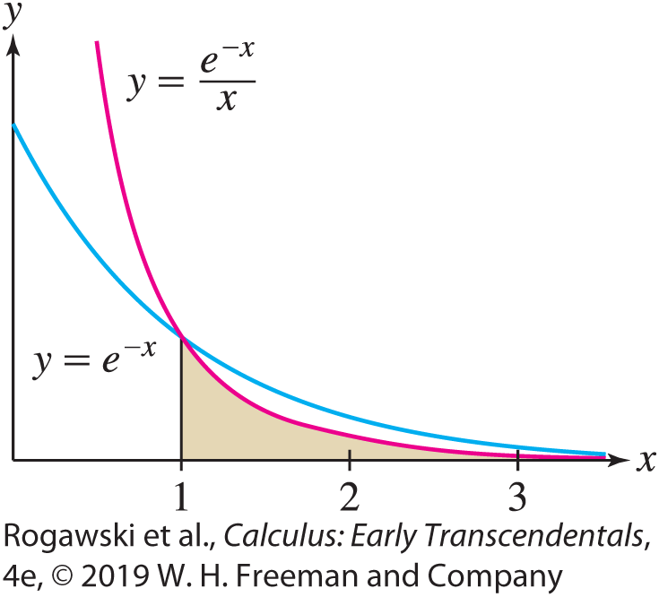

7.7 Improper Integrals (21 of 25)
Sometimes we are interested in determining whether an improper integral converges, even if we cannot find its exact value. For instance, the integral $\int_{1}^{∞}{\frac{e^{−x}}{x}dx}$ cannot be evaluated explicitly. However, if x ≥ 1, then $0≤\frac{1}{x}≤1$, from which we get $0≤\frac{e^{−x}}{x}≤e^{−x}$. In other words, the graph of y = e^{−x}/x lies underneath the graph of y = e^{−x} for x ≥ 1 (Figure 10). Therefore, $0≤\int_{1}^{∞}{\frac{e^{−x}}{x}dx≤}\int_{1}^{∞}{e^{−x}}dx=e^{−1}.$ Since the larger integral converges, we can expect that the smaller integral also converges (and that its value is some positive number less than e⁻¹). This type of conclusion is stated in the next theorem. A proof is provided in a supplement on the text’s Web site.

Slide 115

7.7 Improper Integrals (22 of 25)
THEOREM: Comparison Test for Improper Integrals Assume that f and g are continuous functions such that f (x) ≥ g(x) ≥ 0 for x ≥ a:
If $\int_{a}^{∞}{f(x)}dx$ converges, then $\int_{a}^{∞}{g(x)}dx$ also converges.
If $\int_{a}^{∞}{g(x)}dx$ diverges, then $\int_{a}^{∞}{f(x)}dx$ also diverges.
The Comparison Test is also valid for improper integrals with infinite discontinuities at the endpoints.

Slide 116

7.7 Improper Integrals (23 of 25)
EXAMPLE: (a) We cannot evaluate $\int_{1}^{∞}{\frac{dx}{\sqrt{x^{3}+ 1}}}$ directly, but we can use the Comparison Test. To show convergence, we must compare the integrand (x ³ + 1)^{−1/2} with a larger function whose integral we can compute. It makes sense to compare with x^{−3/2} because $\sqrt{x^{3}}$ ≤ $\sqrt{x^{3}+1}$. Therefore, $\frac{1}{\sqrt{x^{3}+ 1}}≤\frac{1}{\sqrt{x^{3}}}$ and $\int_{1}^{∞}{\frac{dx}{\sqrt{x^{3}}}}$ converges.
(b) We cannot evaluate $\int_{1}^{∞}{\frac{dx}{\sqrt{x} + e^{3x}}}$ directly, but we can use the Comparison Test. To show convergence, observe that $\sqrt{x}+e^{3x}≥e^{3x}≥e^{x}$ for all $x≥1.$ Therefore, $\frac{1}{\sqrt{x} + e^{3x}}≤e^{−x}$. We have shown before that $\int_{1}^{∞}{e^{−x}dx}$ converges. The integral of the larger function converges, so the integral of the smaller function also converges.

Slide 117
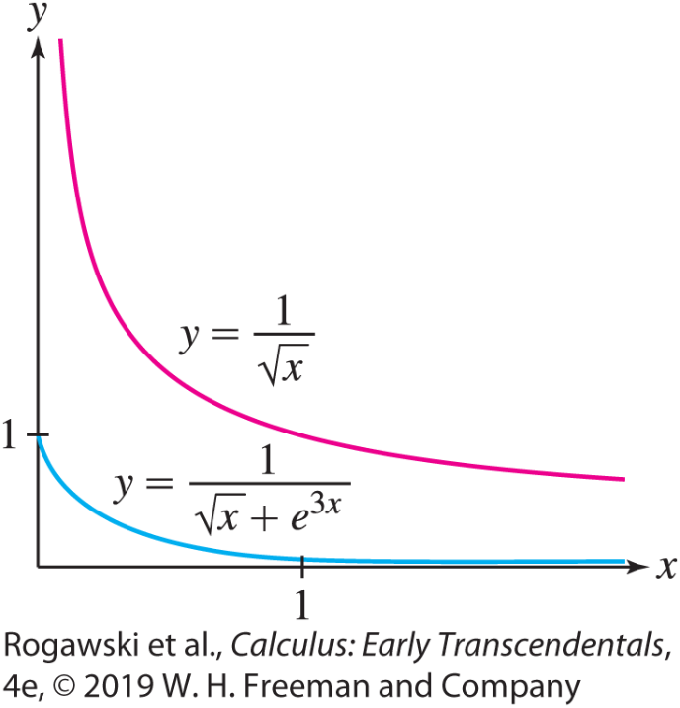

7.7 Improper Integrals (24 of 25)
Had we not been thinking, we might have tried to use the inequality $\frac{1}{\sqrt{x} + e^{3x}}≤\frac{1}{\sqrt{x}}$. However, $\int_{1}^{∞}{\frac{dx}{\sqrt{x}}}$ diverges ( p-integral with p < 1), and this says nothing about our smaller integral (Figure 11).

Slide 118

7.7 Improper Integrals (25 of 25)
EXAMPLE: Endpoint Discontinuity Does $\int_{0}^{0.5}{\frac{dx}{x^{8}+ x^{2}}}$ converge?
This integral is improper, since the denominator approaches 0 whenever x approaches 0. However, the estimate $x^{8}+x^{2}≥x^{2}$ does not help since it yields $\frac{1}{x^{8}+ x^{2}}≤\frac{1}{x^{2}}$ and $\int_{0}^{0.5}{\frac{dx}{x^{2}}}$ diverges.
On the other hand, because 0 < x ≤ 1, we have $x^{8}≤x^{2}.$ Hence, we obtain the estimate $\frac{1}{x^{8}+ x^{2}}≥\frac{1}{2x^{2}}$. Since $\int_{0}^{0.5}{\frac{dx}{2x^{2}}}$ diverges, $\int_{0}^{0.5}{\frac{dx}{x^{8}+ x^{2}}}$ diverges too.

Slide 119
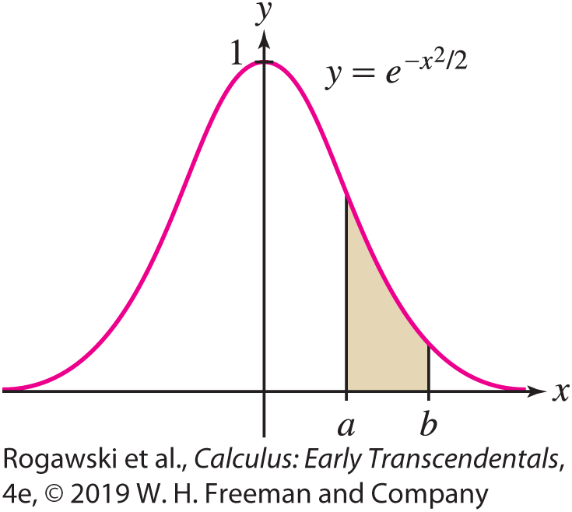
7.8 Numerical Integration (1 of 22)
Numerical integration is the process of approximating a definite integral using well-chosen sums of function values. It is needed when we cannot find an antiderivative explicitly, as in the case of the Gaussian function f (x) = e^{−x /2} (Figure 1).
In Section 5.1, we saw that we can approximate a definite integral by splitting the interval of integration [a, b] into N subintervals, each of size ∆ x. Then we take the value of the function at each left-hand endpoint, multiply that by the width of the interval ∆ x, and sum over the intervals. This approximation is known as the left-endpoint approximation. Similarly, we saw a right-hand approximation. The third method that we introduced in that section, which we reconsider here, uses the midpoints of the intervals, and usually gives a better approximation.

Slide 120
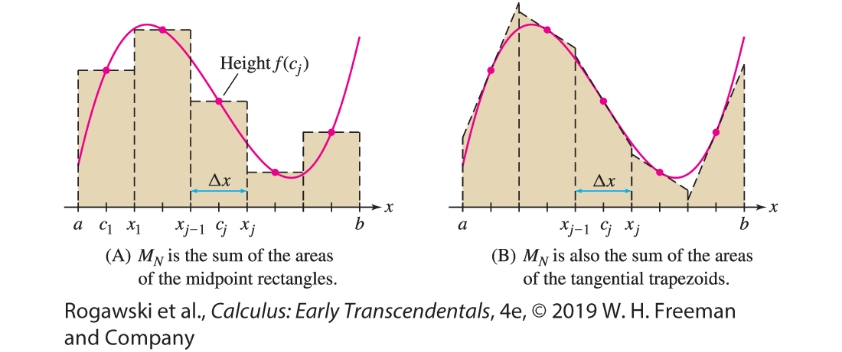

7.8 Numerical Integration (2 of 22)
To approximate the definite integral $\int_{a}^{b}{\text{f} \text{(}\text{x}\text{)} \text{d}\text{x}}$, we fix a whole number N and divide [a, b] into N subintervals of length ∆ x = (b − a)/N . The endpoints of the subintervals are
x₀ = a, x₁ = a + ∆ x , x₂ = a + 2∆ x , ... , x_{N} = b
The midpoint approximation M_{N} is the sum of the areas of the rectangles of height f (c_{j}) and base ∆ x, where c_{j} is the midpoint of the interval [x_{j−1}, x_{j}] [Figure 2(A)].

Slide 121

7.8 Numerical Integration (3 of 22)
Note that the midpoint of [x_{j−1}, x_{j}] is
$$c_{j}=\frac{1}{2}\left(x_{j−1}+x_{j}\right)=\frac{1}{2}\left(2a+\left(2j−1\right)∆x\right)=a+\left(j −\frac{1}{2}\right)∆x$$
Midpoint Rule The Nth midpoint approximation to $\int_{a}^{b}{\text{f} \text{(}\text{x}\text{)} \text{d}\text{x}}$is
M_{N} = ∆ x f (c₁) + f (c₂) + ··· + f (c_{N})
where $∆x=\frac{b − a}{N}$ and $c_{j}=a+(j−\frac{1}{2})∆x$ is the midpoint of [x_{j−1}, x_{j}].
With subinterval endpoints a = x₀, x₁, x₂, ... , x_{N} = b, for a function f , we denote the function value f (x_{j}) by y_{j} throughout the remainder of the section.

Slide 122

7.8 Numerical Integration (4 of 22)
The Trapezoid Rule T_{N} approximates $\int_{a}^{b}{\text{f} \text{(}\text{x}\text{)} \text{d}\text{x}}$by the area of the trapezoids obtained by joining the points (x₀, y₀), (x₁, y₁), ... , (x_{N} , y_{N} ) with line segments, as in Figure 4 on the next slide. The area of the jth trapezoid is $\frac{1}{2}∆x(y_{j−1}+y_{j})$ ), and therefore
T_{N} = $\frac{1}{2}$ ∆ x (y₀ + y₁) + $\frac{1}{2}$ ∆ x (y₁ + y₂) + ··· + $\frac{1}{2}$∆ x (y_{N−1} + y_{N})
= $\frac{1}{2}$ ∆ x (y₀ + y₁ + y₁ + y₂+ ··· + y_{N−1} + y_{N})
= $\frac{1}{2}$ ∆ x (y₀ + 2y₁ + 2y₂+ ··· + 2y_{N−1} + y_{N})
since each value y_{j} occurs twice except for y₀ and y_{N}.

Slide 123
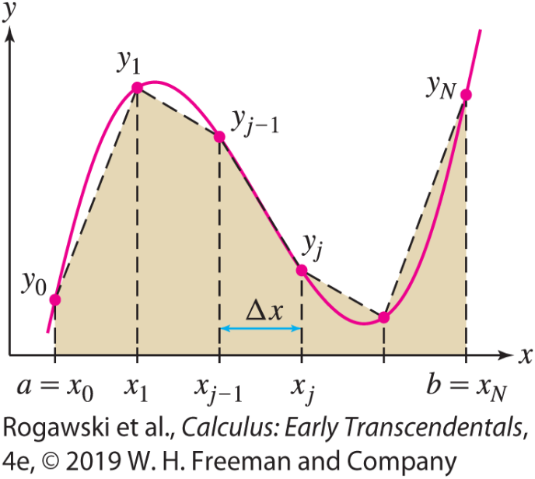

7.8 Numerical Integration (5 of 22)
T_{N} approximates the integral for any f that is integrable over [a, b], so we have the following integral-approximation rule:
Trapezoid Rule The Nth trapezoidal approximation to $\int_{a}^{b}{\text{f} \text{(}\text{x}\text{)} \text{d}\text{x}}$ is
T_{N} = $\frac{1}{2}$ ∆ x (y₀ + 2y₁ + 2y₂+ ··· + 2y_{N −1} + y_{N} )
where $∆x=\frac{b − a}{N}$and y_{j} = f (x_{j}).

Slide 124

7.8 Numerical Integration (6 of 22)
EXAMPLE: We calculate T₈ for the integral $\int_{1}^{3}{\text{sin}\text{(}\text{x} \text{2}\text{)} \text{d}\text{x}}$. Divide [1, 3] into N = 8 subintervals of length $∆x=\frac{3 − 1}{8}=\frac{1}{4}$. Then sum the function values at the endpoints (Figure 6) with the appropriate coefficients:
$$T_{8}=\frac{1}{2}\frac{1}{4}[\text{sin}\text{(12) + 2 }\text{sin}\text{(1.252) + 2 }\text{sin}\text{(1.52) + 2 }\text{sin}\text{(1.752)}$$
$\text{+} \text{2} \text{sin}\text{(22) + 2 }\text{sin}\text{(2.252) + 2 }\text{sin}\text{(2.52) + 2 }\text{sin}\text{(2.752) + }\text{sin}\text{(32)}$] ≈ 0.4281
In general, ∆ x = (3 − 1)/N = 2/N and x_{j} = 1 + 2 j/N. In summation notation,
$$T_{N}=\frac{1}{N}[\sin{1^{2}}+2\sum_{j=2}^{N−1}{\sin{{\left(1+\frac{2j}{N}\right)}^{2}}}+\sin{3^{2}}]$$
The results in Table 1 suggest that $\int_{1}^{3}{\text{sin}\text{(}\text{x} \text{2}\text{)} \text{d}\text{x}}$is approximately 0.4633.
Table 1
N | T_{N}
50 | 0.4624205
100 | 0.4630759
500 | 0.4632855
1000 | 0.4632920
10,000 | 0.4632942

Slide 125

7.8 Numerical Integration (7 of 22)
In applications, it is important to know the accuracy of a numerical approximation. We define the error in M_{N} and T_{N} by
error(M_{N}) = |$\int_{a}^{b}{\text{f} \text{(}\text{x}\text{)} \text{d}\text{x}}$− M_{N} |, error(T_{N}) = |$\int_{a}^{b}{\text{f} \text{(}\text{x}\text{)} \text{d}\text{x}}$− T_{N} |
According to the next theorem, the magnitudes of these errors are related to the size of the second derivative $f′′(x)$. A proof of Theorem 1 is provided in a supplement on the text’s Web site.
THEOREM: Error Bound for M_{N} and T_{N} Assume f$′′$exists and is continuous. Let K₂ be a number such that | $f′′(x)$| ≤ K₂ for all x in [a, b]. Then
$\text{error}\text{(}\text{M}\text{N}\text{)}≤\frac{K_{2}{(b − a)}^{3}}{24N^{2}}$ and $\text{error}\text{(}\text{T}\text{N}\text{)}≤\frac{K_{2}{(b − a)}^{3}}{12N^{2}}$

Slide 126
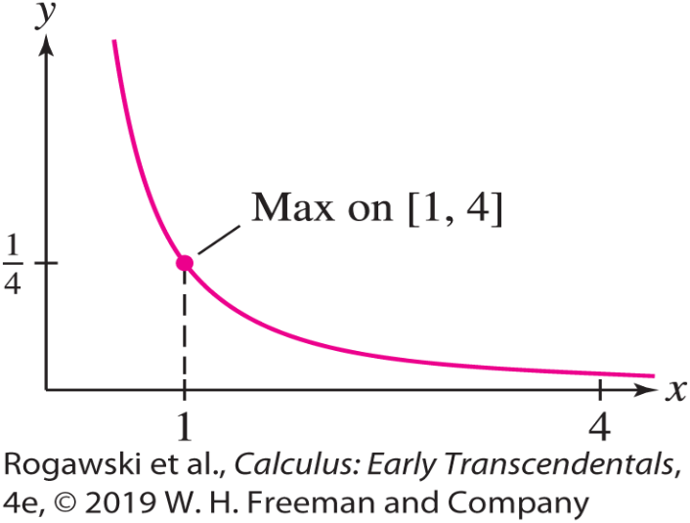

7.8 Numerical Integration (8 of 22)
EXAMPLE: Checking the Error Bound Consider the integral $\int_{1}^{4}{\sqrt{x}}dx$. We calculate M₆ and T₆ for the integral. Divide [1, 4] into six subintervals of width $∆x=\frac{4 − 1}{6}=\frac{1}{2}.$ Then
$$M_{6}=\frac{1}{2}(\sqrt{1.25}+\sqrt{1.75}+\sqrt{2.25}+\sqrt{2.75}+\sqrt{3.25}+\sqrt{3.75})≈\text{4.669245}$$
$$T_{6}=\frac{1}{2}\frac{1}{2}(\sqrt{1}+2\sqrt{1.5}+2\sqrt{2}+2\sqrt{2.}5+2\sqrt{3}+2\sqrt{3.5}+\sqrt{4})≈\text{4.661488}$$
We now find the Error Bounds: $|f^{′′}\left(x\right)|=\frac{1}{4}x^{−3/2}$is decreasing on [1, 4], so its maximum occurs at x = 1. Thus, we choose $K_{2}=\left|f^{′′}\left(1\right)\right|=\frac{1}{4}.$
$\text{error}\text{(}\text{M}\text{N}\text{)}≤\frac{K_{2}{\left(b − a\right)}^{3}}{24N^{2}}=\frac{{(1/4)\left(4 − 1\right)}^{3}}{24 ∙ 6}=\frac{1}{128}≈\text{0.0078}$
$$\text{error}\text{(}\text{T}\text{N}\text{)}≤\frac{K_{2}{\left(b − a\right)}^{3}}{12N^{2}}=\frac{(1/4){\left(4 − 1\right)}^{3}}{12 ∙ 6}=\frac{1}{64}≈\text{0.0156}$$

Slide 127

7.8 Numerical Integration (9 of 22)
$$\int_{1}^{4}{\sqrt{x}}dx=\frac{2}{3}x^{3/2}|_{1}^{4}=\frac{14}{3}$$
Therefore,
error(M₆) ≈ 0.00258 (less than Error Bound 0.0078)
error(T₆) ≈ 0.00518 (less than Error Bound 0.0156)
The actual errors are less than the Error Bound, so Theorem 1 is verified.

Slide 128
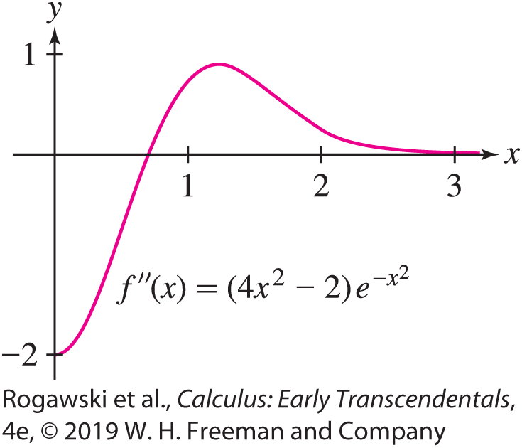

7.8 Numerical Integration (10 of 22)
The Error Bound can be used to determine values of N so that M_{N} or T_{N} approximates an integral to a given accuracy.
EXAMPLE: We find N such that T_{N} approximates $\int_{0}^{3}{e^{−x^{2}}}dx$ with an error of at most 10⁻⁴. Since $f^{′}\left(x\right)=−2xe^{−x^{2}}$ and $f^{′′}\left(x\right)=(4x^{2}−2)e^{−x^{2}}$, we use a graphing utility to plot $f^{′′}\left(x\right)$. The graph shows that the maximum of $\left|f^{′′}\left(x\right)\right|$ on [0, 3] occurs at x = 0. So, we take $K_{2}=\left|f^{′′}\left(0\right)\right|=2$ in the Error Bound:
$\text{error}\text{(}\text{T}\text{N}\text{)}≤\frac{K_{2}{\left(b − a\right)}^{3}}{12N^{2}}=\frac{2 ∙ 27}{12N^{2}}=\frac{9}{2N^{2}}<{10}^{−4}$
We solve for N and obtain $N>\frac{300}{\sqrt{2}}≈212.1.$
Thus, we choose N = 213.
A CAS shows that T₂₁₃ ≈ 0.8862.

Slide 129

7.8 Numerical Integration (11 of 22)
As we have seen, the Midpoint Rule uses trapezoids that are tangent to the curve to approximate the area under the curve. The Trapezoid Rule uses trapezoids with vertices on the curve to approximate the area. In both cases, the top edge of each trapezoid is a straight line segment. One must wonder whether we could do better using some other curve at the top of each region. In Simpson’s Rule, we replace the line segments with parabolas, allowing us to obtain an approximation that is usually substantially more accurate.
To begin, we again subdivide [a, b] into N subintervals, each of length $∆x=\frac{b − a}{N}$. However, we require N to be even. Then we pair up the resulting intervals, [x₀, x₁] with [x₁, x₂], [x₂, x₃] with [x₃, x₄], and so on. For each pair of intervals, we find a parabola that passes through the three points on the curve associated with the endpoints of the two intervals, as in Figure 11. Then we take the sum of the areas that are under the parabolas and over the corresponding intervals to approximate the area under the curve.

Slide 130
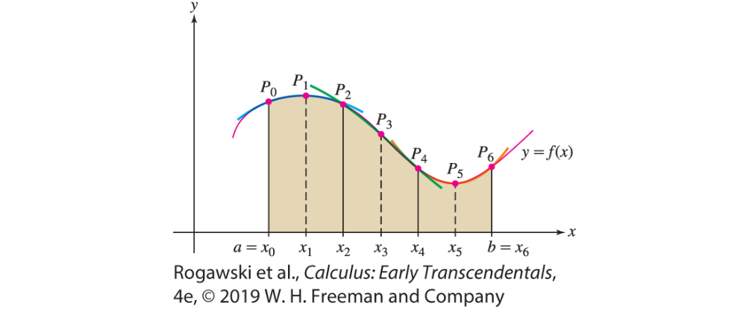
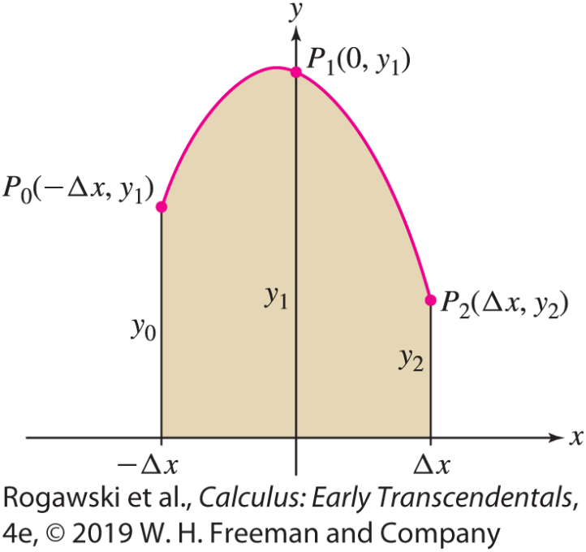
7.8 Numerical Integration (12 of 22)
Our goal is to develop an approximation formula that, like the Trapezoid Rule, expresses the approximation in terms of the function values, y_{i} = f (x_{i}), at the subinterval endpoints.
We begin with the case of a pair of intervals [−∆ x, 0] and [0, ∆ x] centered around the origin. We assume that the corresponding three points on the curve are P₀(−∆ x, y₀), P₁(0, y₁), and P₂(∆ x, y₂). See Figure 12.
Recall that the general equation for a parabola is
y = Cx ² + Dx + E for constants C, D, and E . The area that is under the parabola and above the two intervals
[−∆ x, 0] and [0, ∆ x] is obtained by integrating

Slide 131

7.8 Numerical Integration (13 of 22)
$$area=\int_{−∆x}^{∆x}{\left(Cx^{2}+Dx+E\right)dx}=(\frac{C}{3}x^{3}+\frac{D}{2}x^{2}+Ex)|_{−∆x}^{∆x}$$
$$=\frac{∆x}{3}\left(2C{\left(∆x\right)}^{2}+6E\right)$$
We want to express this area in terms of the values y₀, y₁, and y₂. Because the parabola must pass through the three points P₀, P₁, and P₂, we know the coordinates of each must satisfy the equation of the parabola. Hence, we obtain the three equations
y₀ = C(∆ x )² − D∆ x + E, y₁ = E, y₂ = C(∆ x )² + D∆ x + E
Multiplying the middle equation through by 4 and then adding the three equations yields
y₀ + 4y₁ + y₂ = 2C(∆ x )² + 6E

Slide 132

7.8 Numerical Integration (14 of 22)
Therefore, it follows that the area under the parabola is given by $\frac{∆x}{3}($y₀ + 4y₁ + y₂). This area depends only on the y-coordinates of the three points, so we obtain a similar expression if we site the parabola over any of the subsequent pairs of adjacent subintervals. Therefore, we can approximate the area under the curve by
$\frac{∆x}{3}($y₀ + 4y₁ + y₂) ₊ $\frac{∆x}{3}($y₂ + 4y₃ + y₄) + … + $\frac{∆x}{3}($y_{N–2} + 4y_{N–1} + y_{N})
Simplifying, we obtain the following approximation formula that is valid for any function f that is integrable over [a, b]:

Slide 133

7.8 Numerical Integration (15 of 22)
Simpson’s Rule
For N even, the Nth approximation to $\int_{a}^{b}{f\left(x\right)dx}$ by Simpson’s Rule is
S_{N} = $\frac{∆x}{3}($y₀ + 4y₁ + 2y₂ + 4y₃ + y₄) + … + 4y_{N−3} + 2y_{N–2} + 4y_{N–1} + y_{N})
where $∆x=\frac{b − a}{N}$and y_{j} = f (x_{j}).

Slide 134

7.8 Numerical Integration (16 of 22)
As mentioned previously, we derived the approximation rules in this section in the case
f (x ) ≥ 0 in order to make it easier to picture the computations in terms of area.
The Midpoint Rule, the Trapezoid Rule, and Simpson’s Rule apply to any integrable function.
EXAMPLE: We use Simpson’s Rule with N = 8 to approximate $\int_{2}^{4}{\sqrt{1+x^{3}}}dx.$ We have ∆ x = $\frac{4 − 2}{8}$ = $\frac{1}{4}$. Thus,
$$S_{8}=\frac{1}{3}\frac{1}{4}[\sqrt{1+2^{3}}+4\sqrt{1+{2.25}^{3}}+2\sqrt{1+{2.5}^{3}}+4\sqrt{1+{2.75}^{3}}$$
$$+ 2\sqrt{1+3^{3}}+4\sqrt{1+{3.25}^{3}}+2\sqrt{1+{3.5}^{3}}+4\sqrt{1+{3.75}^{3}}+\sqrt{1+4^{3}}]≈\text{10.74159}$$

Slide 135
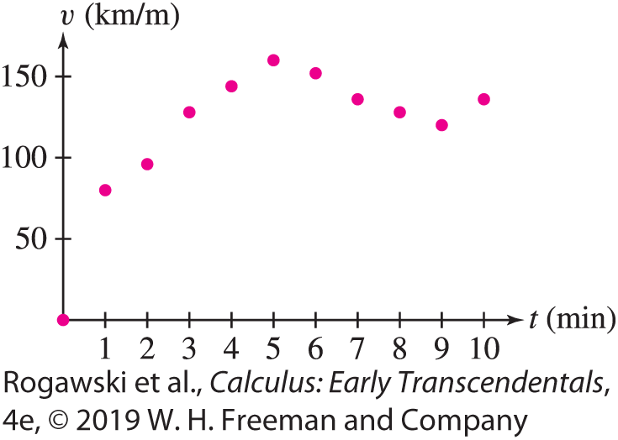
7.8 Numerical Integration (17 of 22)
EXAMPLE: Estimating Integrals from Numerical Data The velocity (in kilometers per hour) of a Piper Cub aircraft traveling due west is recorded every minute during the first 10 min after takeoff. We use Simpson’s Rule to estimate the distance traveled.
The distance traveled is the integral of velocity. 1
t (min) | 0 | 1 | 2 | 3 | 4 | 5 | 6 | 7 | 8 | 9 | 10
v (t) (km/h) | 0 | 80 | 100 | 128 | 144 | 160 | 152 | 136 | 128 | 120 | 136

Slide 136

7.8 Numerical Integration (18 of 22)
We convert from minutes to hours because velocity is given in kilometers per hour, and thus we apply Simpson’s Rule, where the number of intervals is N = 10 and each interval has length $∆t=\frac{1}{60}$ h.
$$S_{10}=\frac{1}{3}\frac{1}{60}(0+ \text{4(80}\text{)} \text{+} \text{2(100}\text{)} \text{+} \text{4(128}\text{)} \text{+} \text{2(144}\text{)} \text{+} \text{4(160)}$$
$$\text{+} \text{2(152}\text{)} \text{+} \text{4(136}\text{)} \text{+} \text{2(128}\text{)} \text{+} \text{4(120}\text{)} \text{+} \text{136}) \text{≈} \text{20.}\text{4} \text{km}$$
The distance traveled is approximately 20.4 km (Figure 14).

Slide 137

7.8 Numerical Integration (19 of 22)
We now state (without proof) the Error Bound for Simpson’s Rule. Set
error(S_{N}) =|$\int_{a}^{b}{f(x)}dx−S_{N}|$
The error involves the fourth derivative, which we assume exists and is continuous.
THEOREM: Error Bound for S_{N} Let K₄ be a number such that | f ⁽⁴⁾(x )| ≤ K₄ for all
x ∈ [a, b]. Then
$$\text{error}\text{(}\text{S}\text{N}\text{)}≤\frac{K_{4}{(b−a)}^{5}}{180N^{4}}$$

Slide 138

7.8 Numerical Integration (20 of 22)
EXAMPLE: For $\int_{1}^{3}{\frac{dx}{x}}$ and N = 8, we have $∆x=\frac{3 − 1}{8}=\frac{1}{4}.$ So,
$$S_{8}=\frac{1}{3}\frac{1}{4}(1+4\frac{4}{5}+2\frac{4}{6}+4\frac{4}{7}+2\frac{4}{8}+4\frac{4}{9}+2\frac{4}{10}+4\frac{4}{11}+3)≈\text{1.09873}$$
Moreover, $f^{\left(4\right)}\left(x\right)=24x^{−5}$ is decreasing, so the max of | f ⁽⁴⁾(x )| on [1, 3] is | f ⁽⁴⁾(1)|= 24. Therefore, we use the Error Bound with K₄ = 24:
$$\text{error}\text{(}\text{S}\text{N}\text{)}≤\frac{K_{4}{\left(b−a\right)}^{5}}{180N^{4}}=\frac{24∙2^{5}}{180N^{5}}=\frac{64}{15N^{4}}$$
For N = 8, this formula gives $\text{error}\text{(}\text{S}\text{8}\text{)}≤ =\frac{1}{960}\text{≈} \text{0.001}\text{.}$ On the other hand, the error will be at most 10⁻⁶ if N satisfies $\frac{64}{15N^{4}}<{10}^{−6}.$ Solving for N, we get $N>{\left(\frac{{10}^{6}15}{64}\right)}^{1/4}≈45.45.$ Thus, we may take N = 46. Using technology, we find that S₄₆ ≈ 1.098612. The exact value of the integral is $\ln{3}$, and therefore we have determined ln 3 ≈ 1.098612 with an error less than 10⁻⁶.

Slide 139

7.8 Numerical Integration (21 of 22)
EXAMPLE: For $\int_{1}^{3}{\frac{dx}{x}}$ and N = 8, we have $∆x=\frac{3 − 1}{8}=\frac{1}{4}.$ So,
$$S_{8}=\frac{1}{3}\frac{1}{4}(1+4\frac{4}{5}+2\frac{4}{6}+4\frac{4}{7}+2\frac{4}{8}+4\frac{4}{9}+2\frac{4}{10}+4\frac{4}{11}+3)≈\text{1.09873}$$
Moreover, $f^{\left(4\right)}\left(x\right)=24x^{−5}$ is decreasing, so the max of | f ⁽⁴⁾(x )| on [1, 3] is | f ⁽⁴⁾(1)|= 24. Therefore, we use the Error Bound with K₄ = 24:
$$\text{error}\text{(}\text{S}\text{N}\text{)}≤\frac{K_{4}{\left(b−a\right)}^{5}}{180N^{4}}=\frac{24∙2^{5}}{180N^{5}}=\frac{64}{15N^{4}}$$

Slide 140

7.8 Numerical Integration (22 of 22)
For N = 8, this formula gives $\text{error}\text{(}\text{S}\text{8}\text{)}≤=\frac{1}{960}\text{≈} \text{0.001}\text{.}$
On the other hand, the error will be at most 10⁻⁶ if N satisfies $\frac{64}{15N^{4}}<{10}^{−6}.$ Solving for N, we get
$$N>{\left(\frac{{10}^{6}15}{64}\right)}^{1/4}≈45.45$$
Thus, we may take N = 46. Using technology, we find that S₄₆ ≈ 1.098612. The exact value of the integral is $\ln{3}$, and therefore we have determined ln 3 ≈ 1.098612 with an error less than 10⁻⁶.

